Slide 1

Bierer & Associates, Inc.

Slide 2
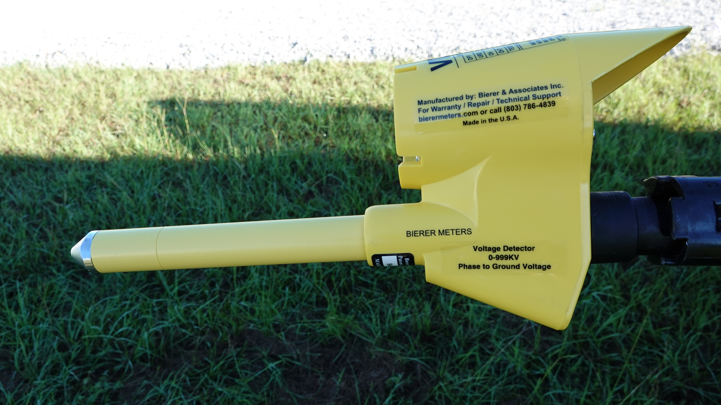
VD1000
Per ASTM F1796 10.3.2
A Type II (Numerical Indication) voltage detector
“Each unit shall be subjected to the voltage necessary to verify the units
Nominal design voltage range/s, within +/-30% of applied voltage” (Don’t Panic!)
Example:
Working in a 7.2kV phase-to-ground (12.5kV phase-to-phase) system voltage. Per ASTM F1796, a Type II voltage detector has an
allowable range of 5kV to 9.4kV display, worse case conditions.

Slide 3


VD1000 Anatomy
All Switch Positions
are Overload Protected
9V Battery Behind
Live Line Tool Fitting
Thermally Conductive
Electrically Non-Conductive
Epoxy Encapsulated Probe
Conductive Tip
Limit Mark per ASTM
F1796 3.1.9
25 Million Ohm
High Resistance Probe
Live Line Tool
Fitting Adapter
Industry Standard
¼ 20 Female Thread for
Various Adapters
Modular, High Impact,
Water Resistant,
Electrically Shielded Housing

Slide 4
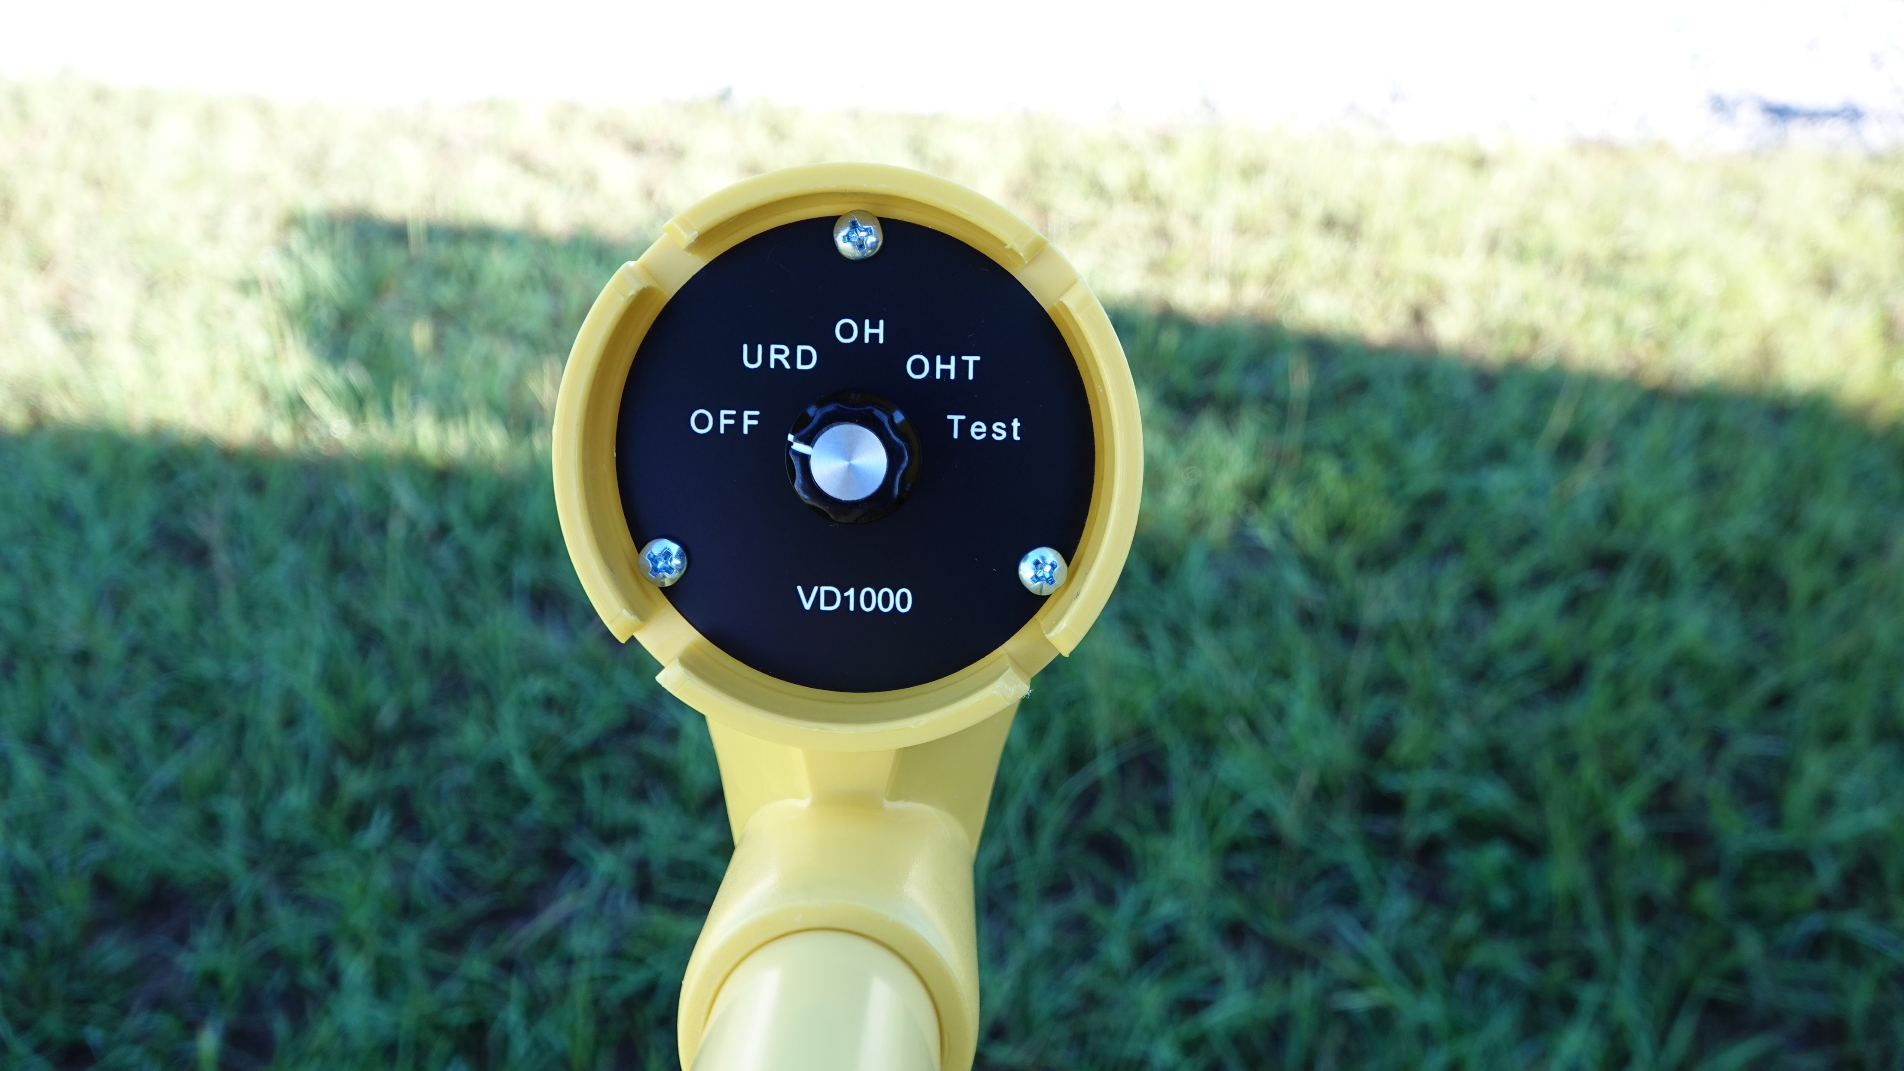
“OFF” Switch Position
Switch Position Used
for Transit or Storage
No drain on battery, good
for its shelf life

Slide 5
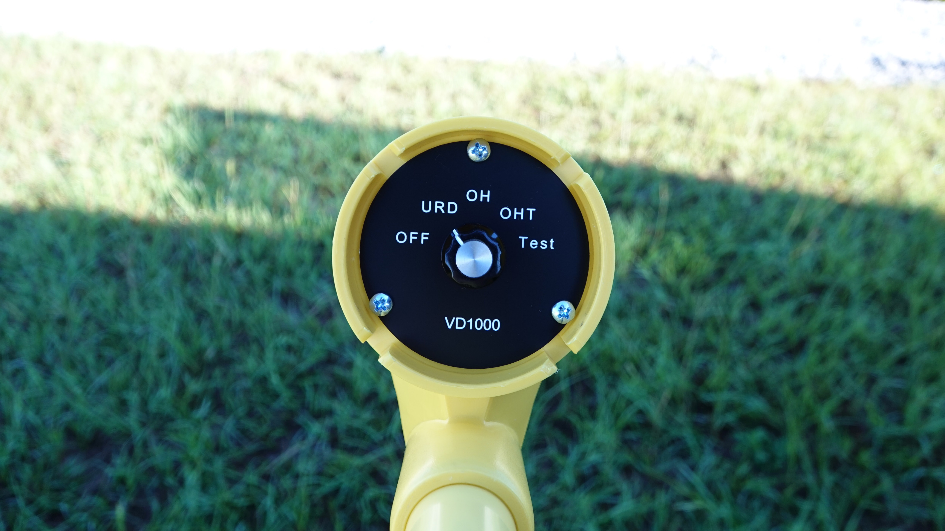
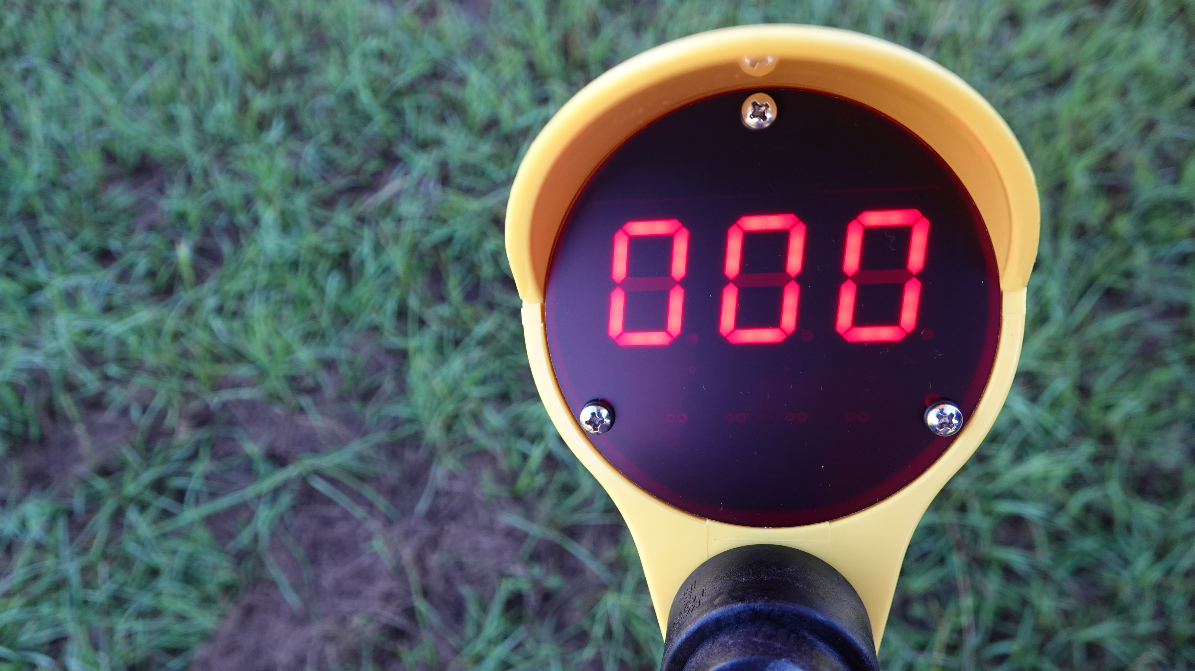
“URD” Switch Position
Underground Residential Distribution
Switch Position Used to Measure
Primary Voltages close to Earth
Specifically Calibrated to Measure
6ft. or less above Ground
Overload Protected Circuitry
Automatic “OFF” Function if battery
voltage is too low

Slide 6
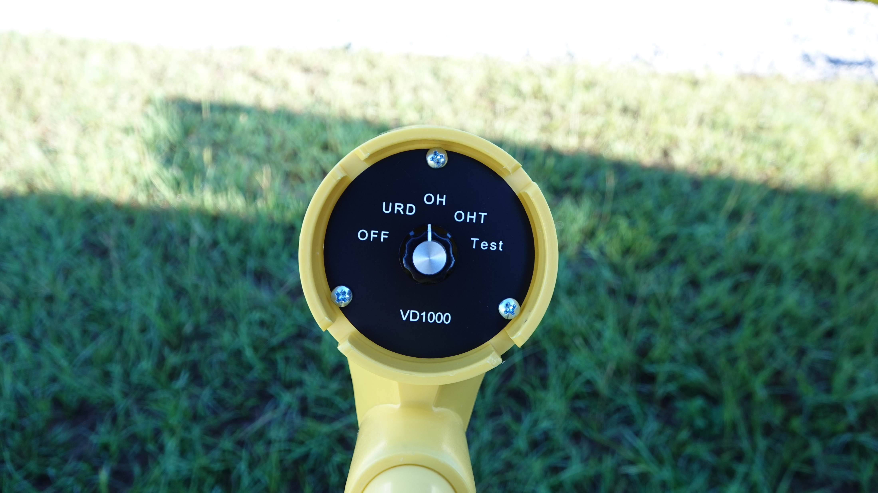
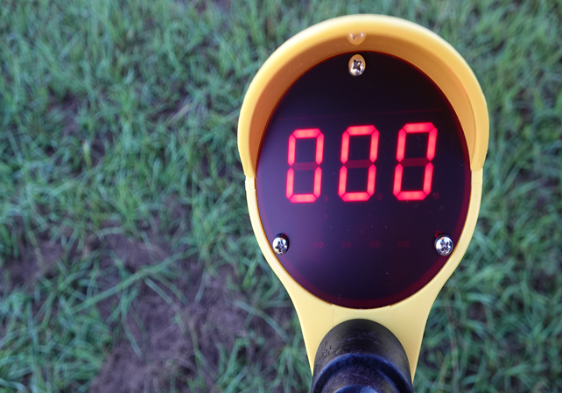
“OH” Switch Position
OverHead
Switch Position Used to Measure
Primary Voltages at Distribution
Overhead Heights
Specifically Calibrated to Measure
20-40ft. above Ground.
Overload Protected Circuitry
Automatic “OFF” Function if battery
voltage is too low

Slide 7
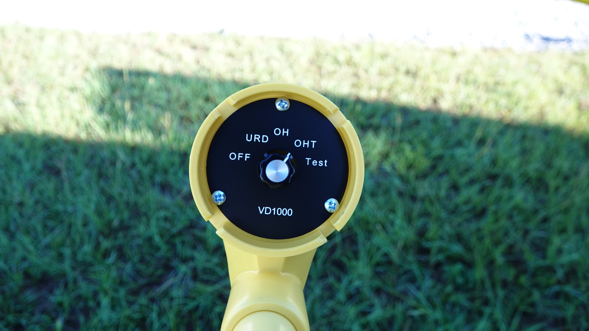
“OHT” Switch Position
OverHead Transmission
Switch Position Used for
Transmission Voltages Only
Specifically Calibrated to Measure
40ft. or Greater Above Ground
Automatic “OFF” Function if battery
voltage is too low

Slide 8
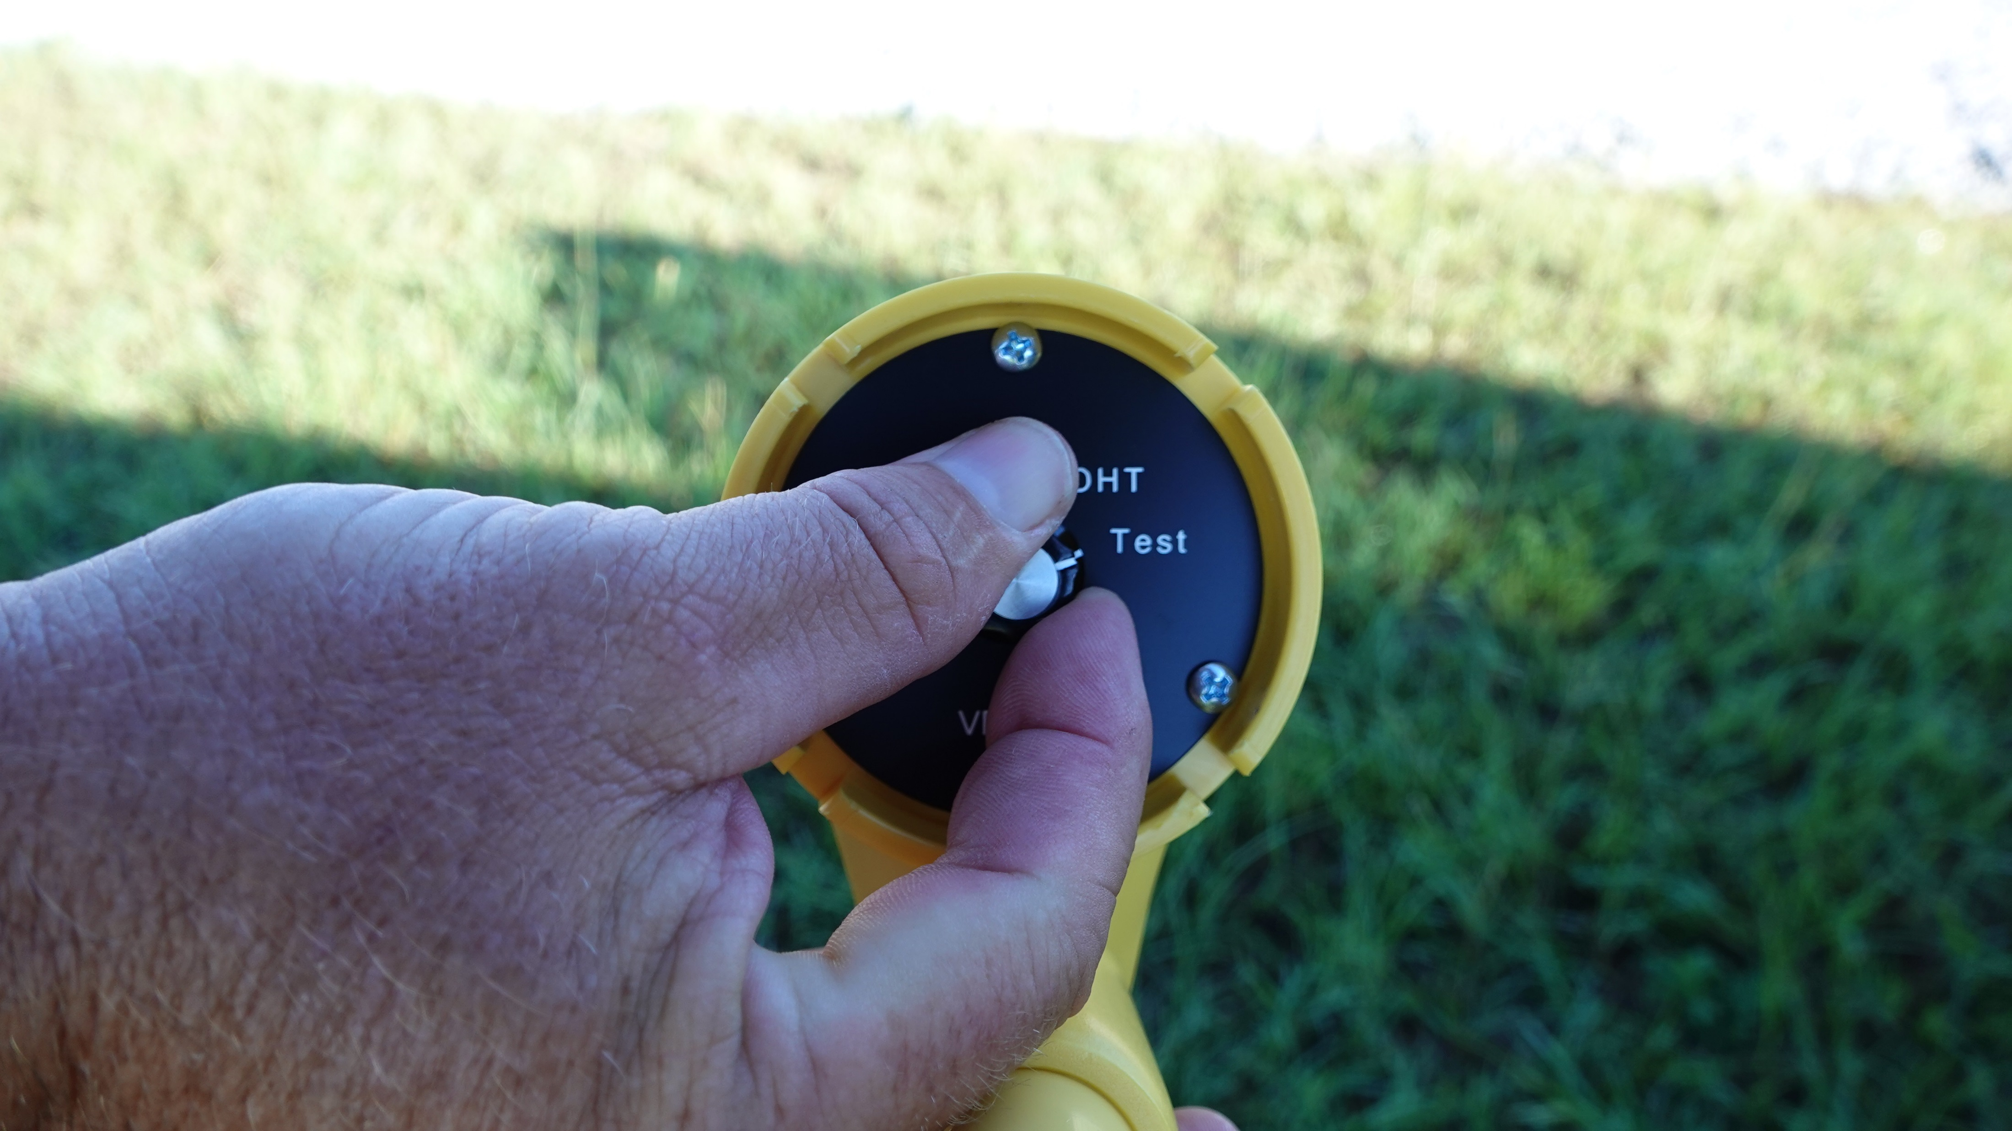
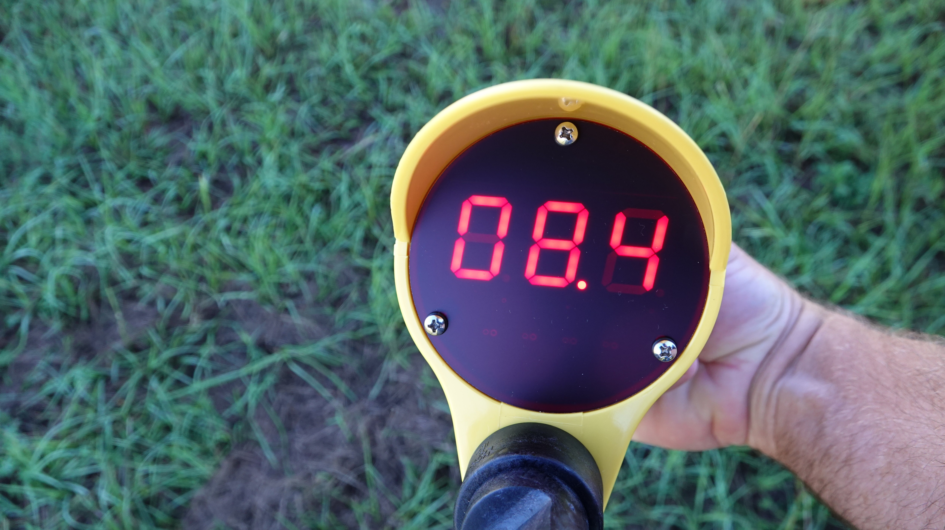
“Test” Switch Position
Switch Position Used to
Perform a “Self-Test”
Spring-Loaded Switch Position
will not drain the Battery
Uses the Internal Battery Voltage
to Test > 90% of the Circuitry
Displays Internal Battery Voltage
Level, Replace Battery < 7V
This Test should be Performed
Before and After each Use

Slide 9
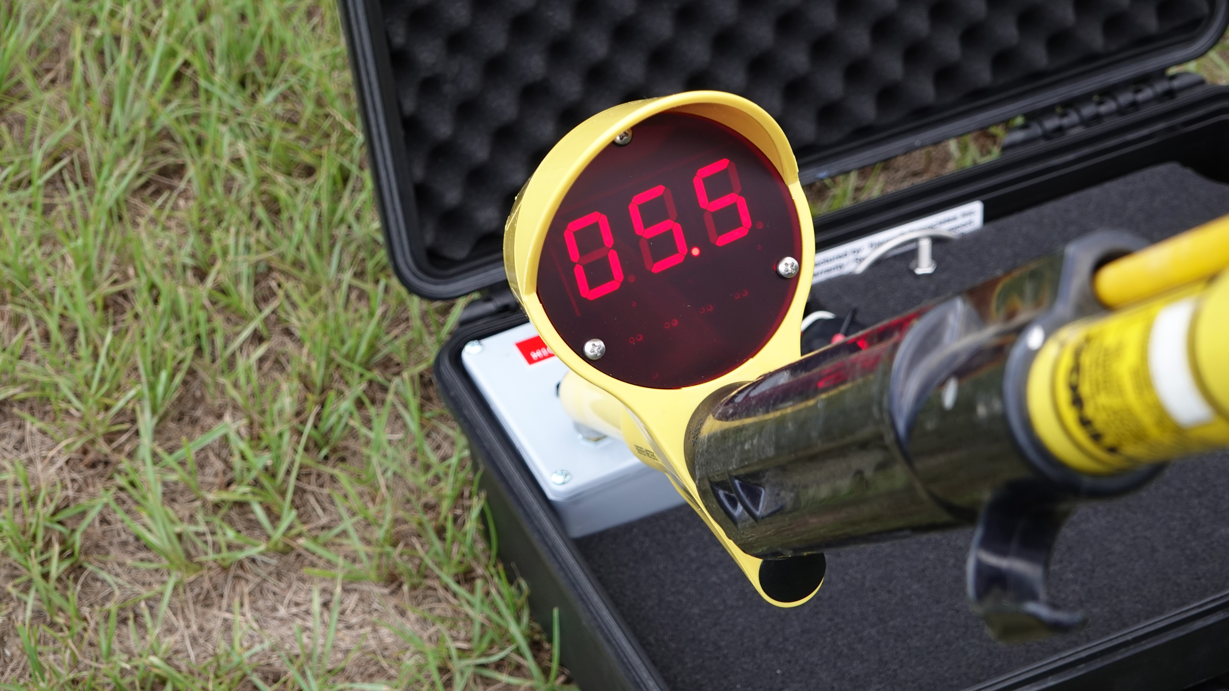
“Known Voltage Test”
Before and After each Use
3kV Power Supply (shown) or any
other known potential source

Slide 10
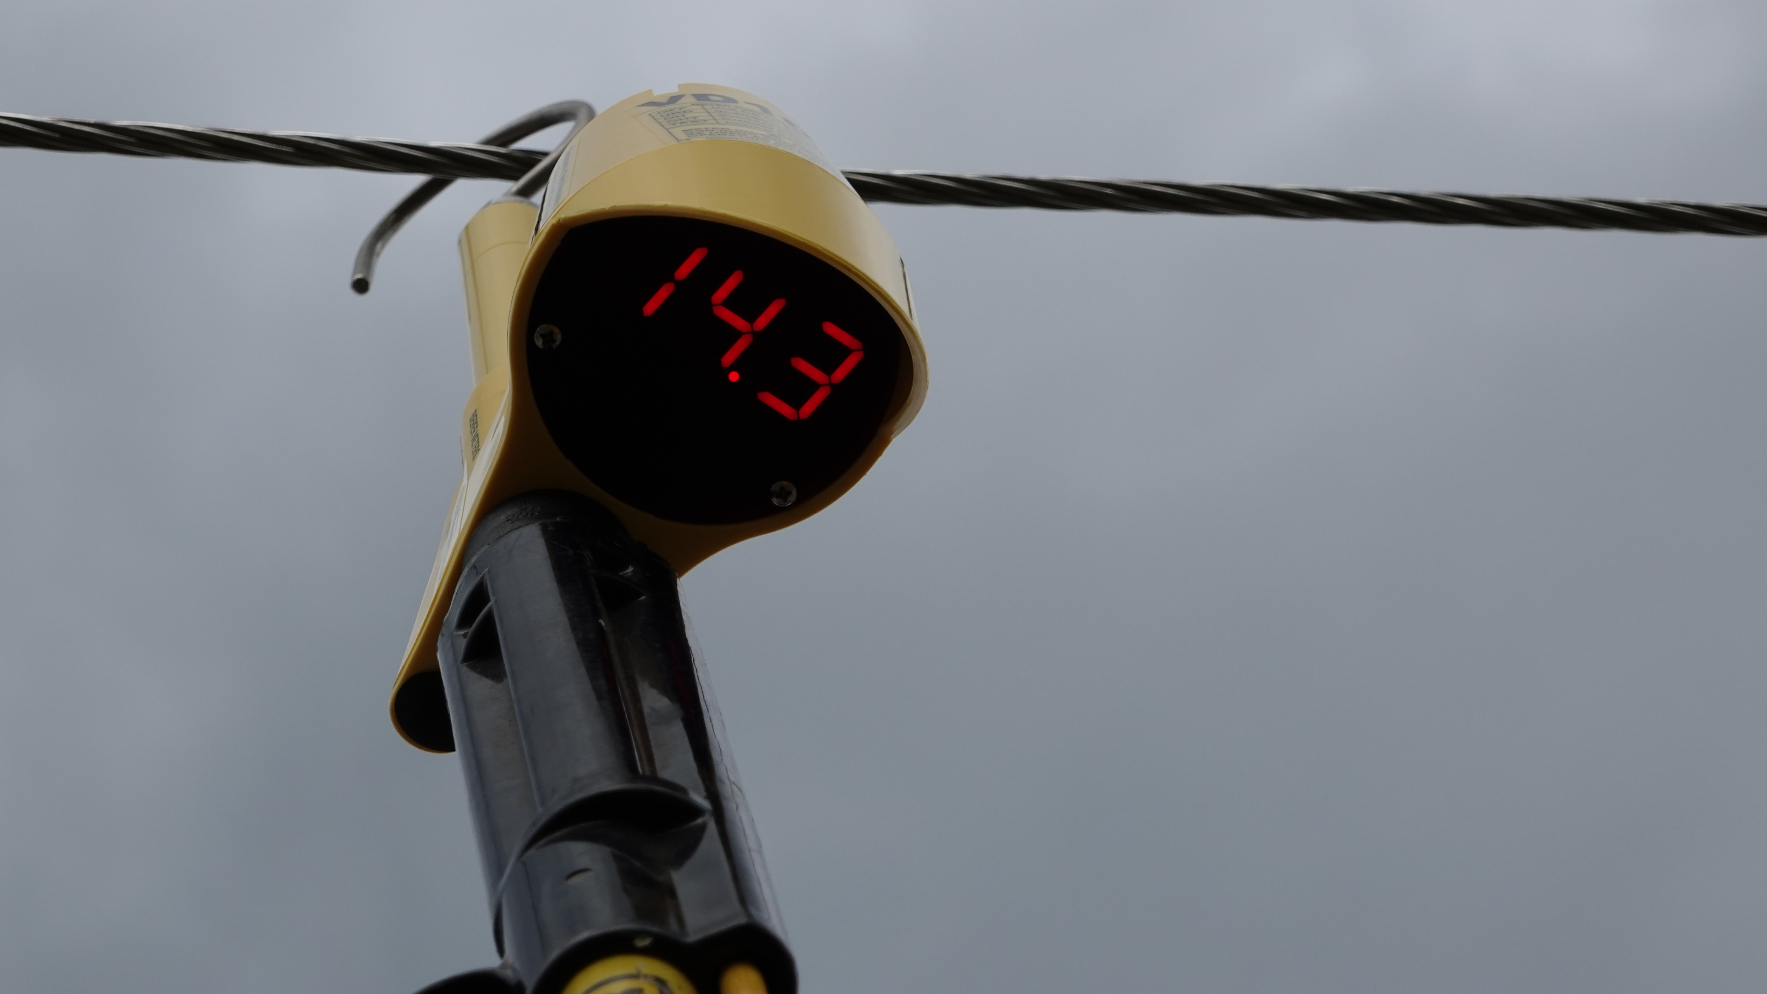

A Voltage Detector Requires Current!!
Energized Potential
Meter MUST Capacitively couple to a Ground Potential
on the opposite end of the Energized Potential to work Correctly
Only 50 Micro-Amps are required for Full Scale Display
Ground Potential

Slide 11
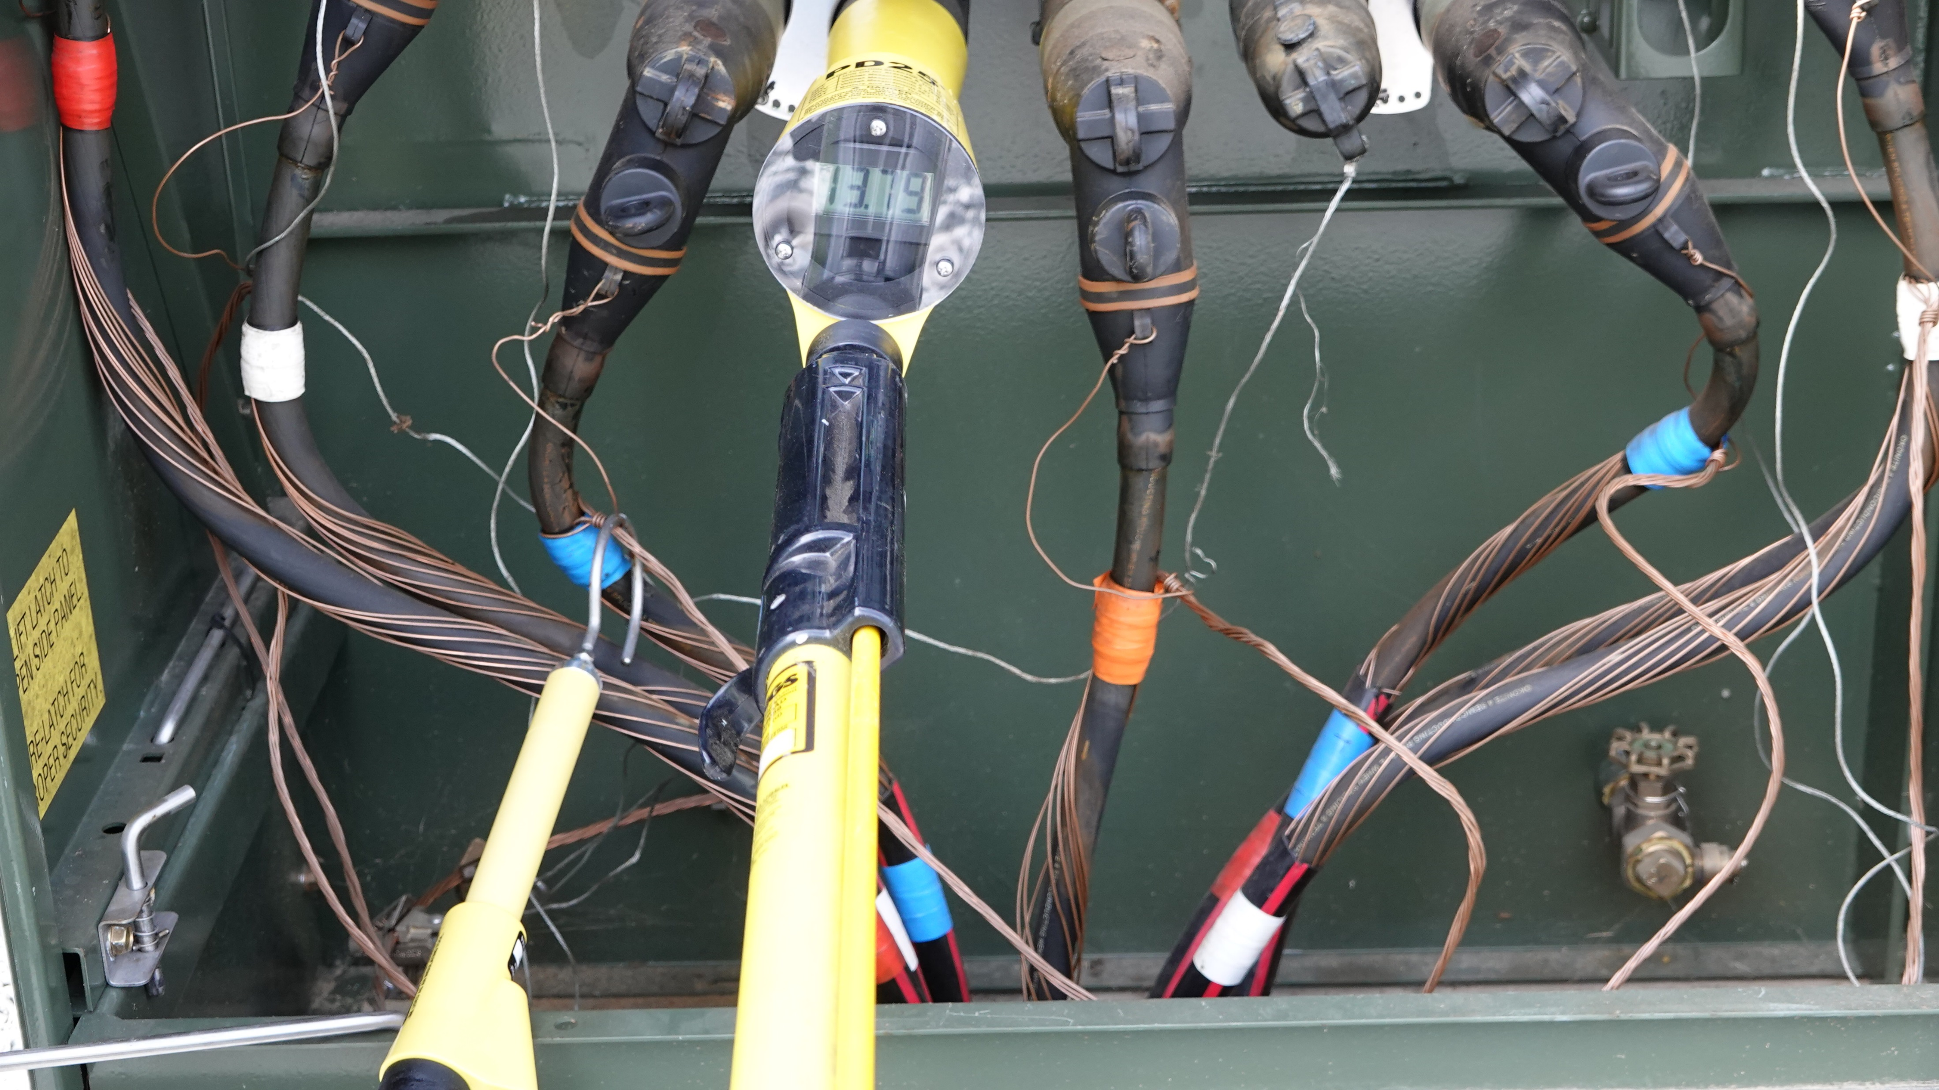
True RMS Voltage Test
With the Bierer PD25
Voltage = 13.79kV plus or minus 1%
Use this voltage as a comparison to
the VD1000 nominal voltage readings

Slide 12
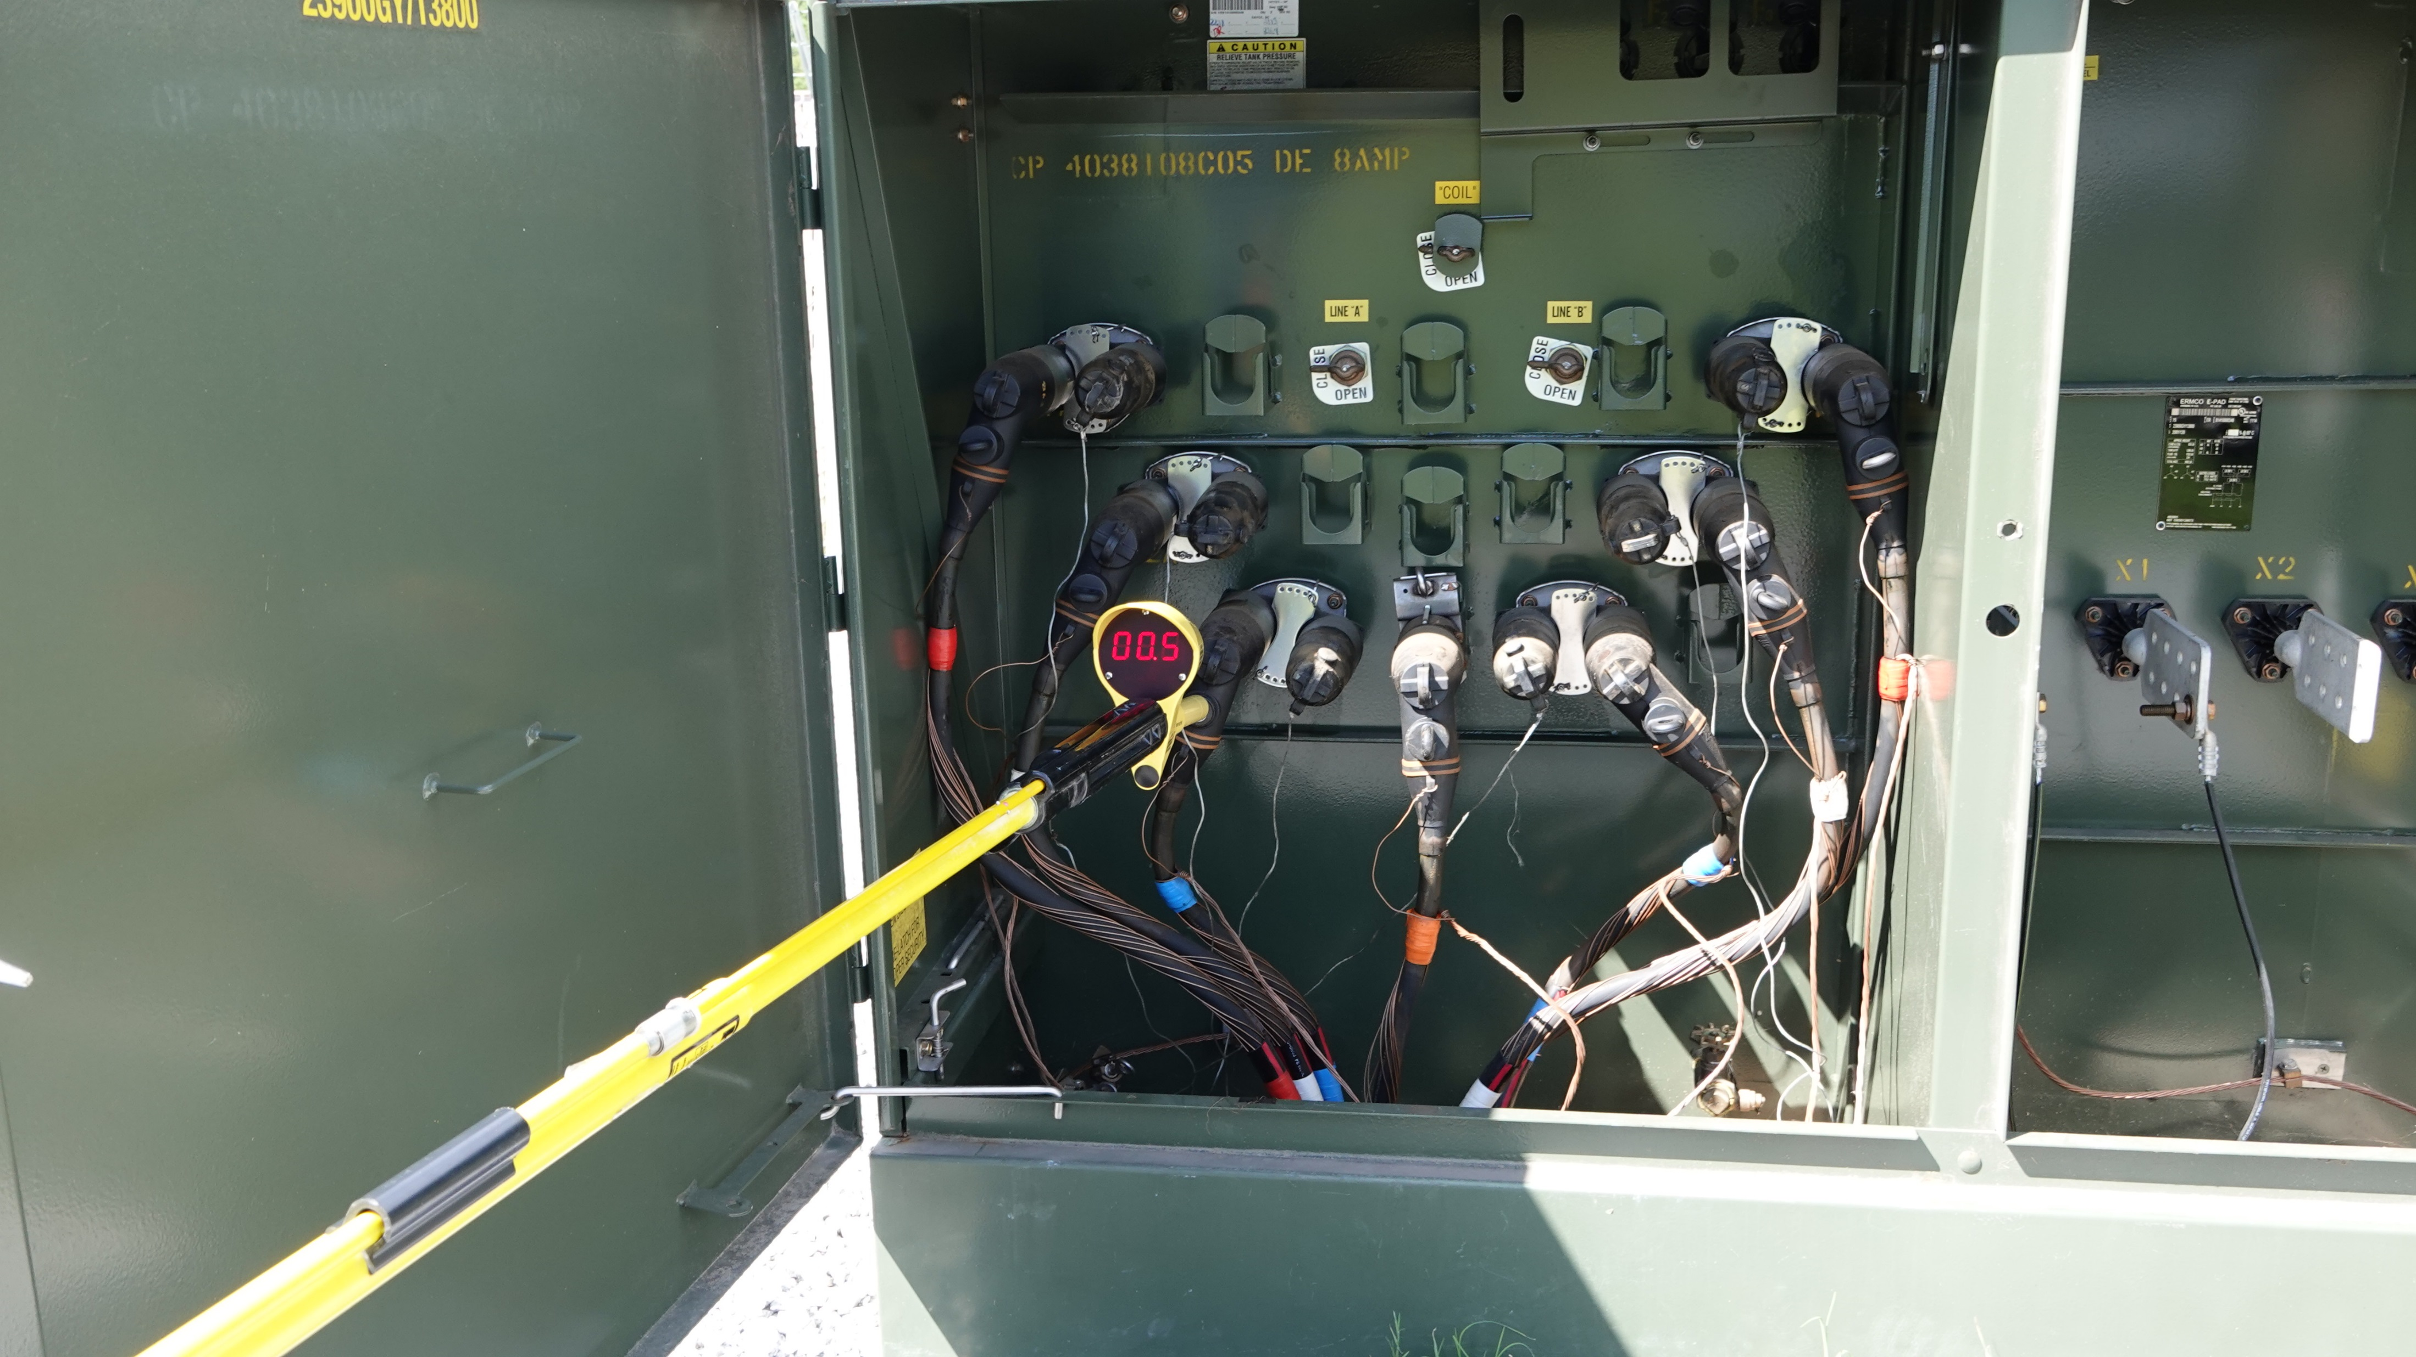
URD Switch Position
Capacitive Test Point
Nominal Voltage Reading
of 500 Volts
Hot or Not Primary Voltage
Indication

Slide 13
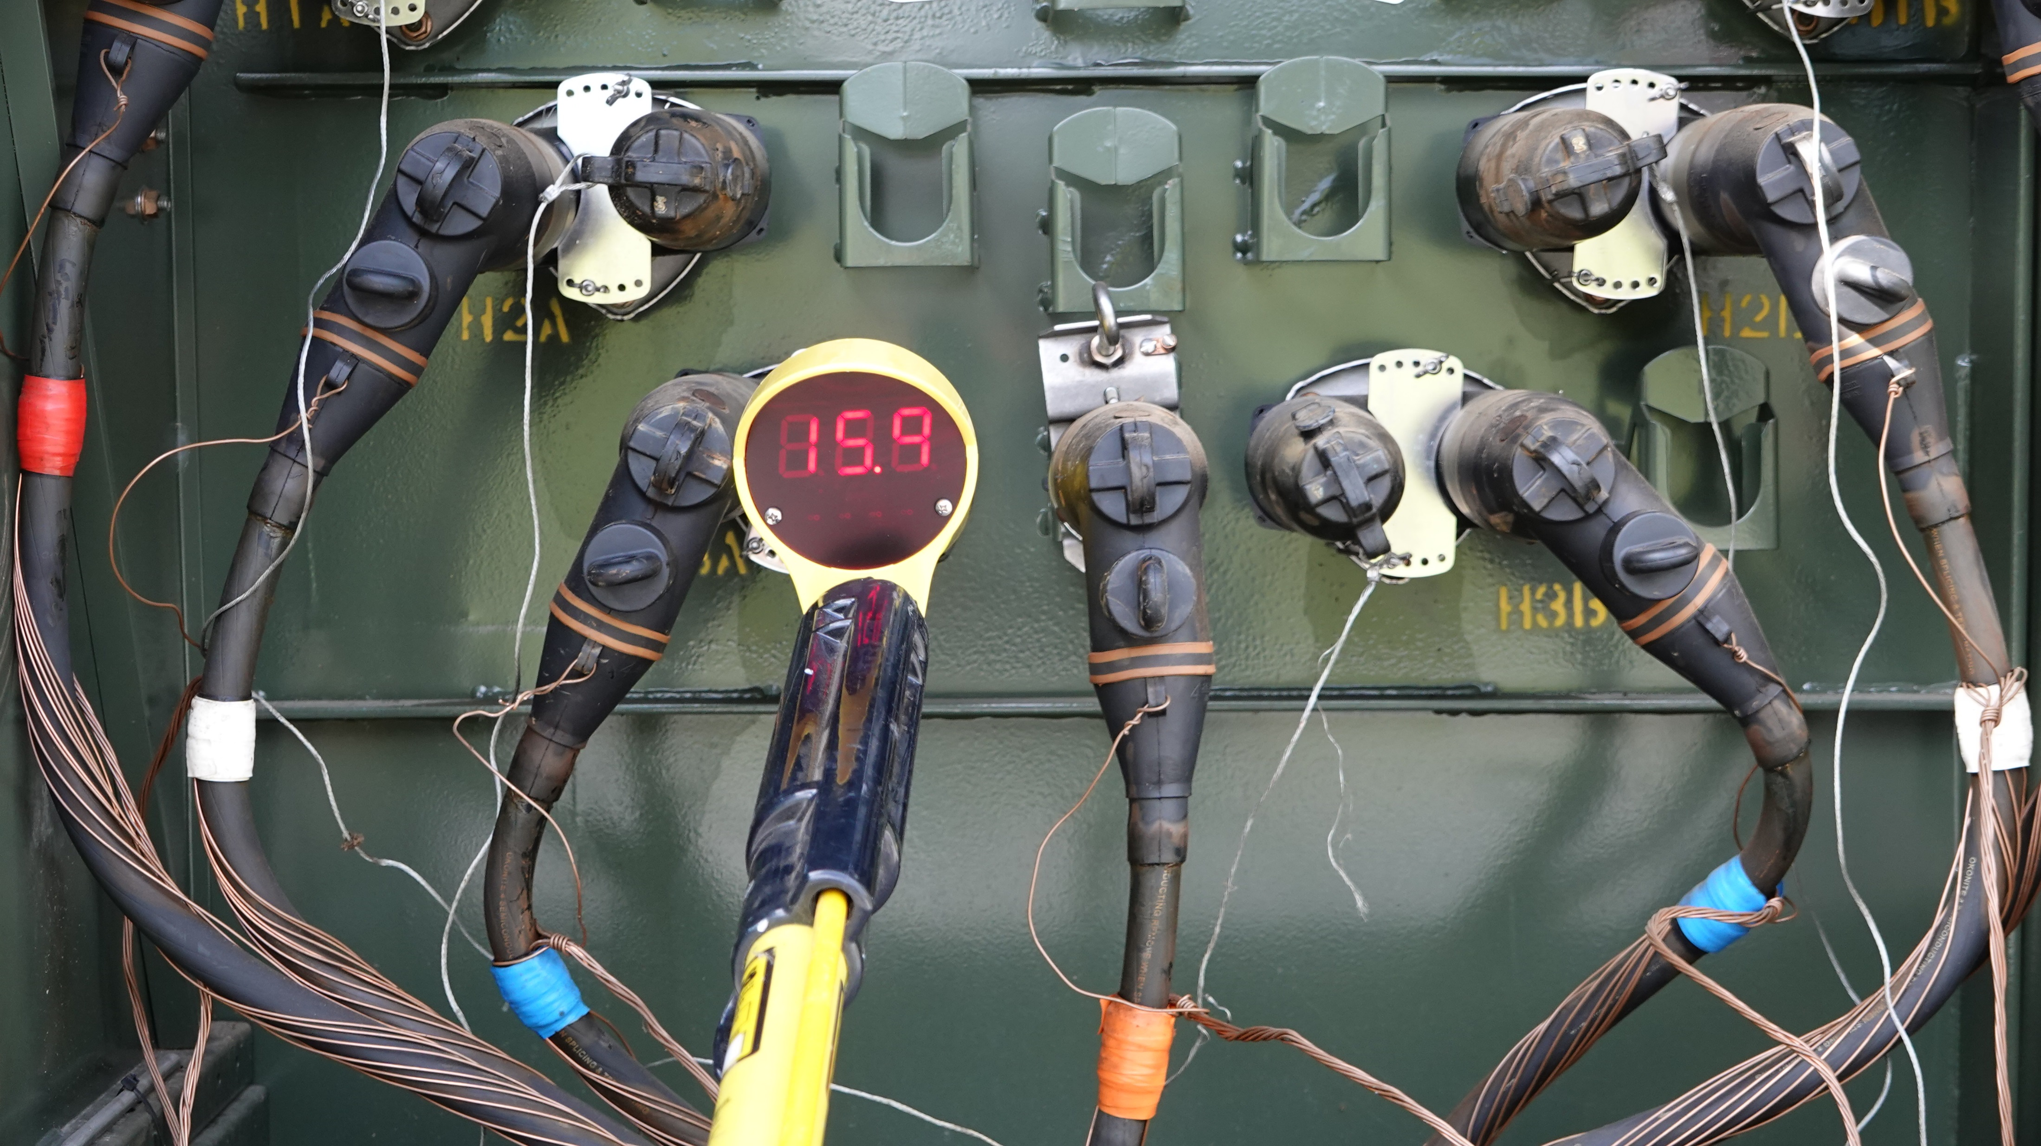

URD Switch Position
Good Spacing
Nominal voltage reading
inside padmount of 15.9kV
with good perimeter spacing
Reading is almost within
10% of RMS reading

Slide 14
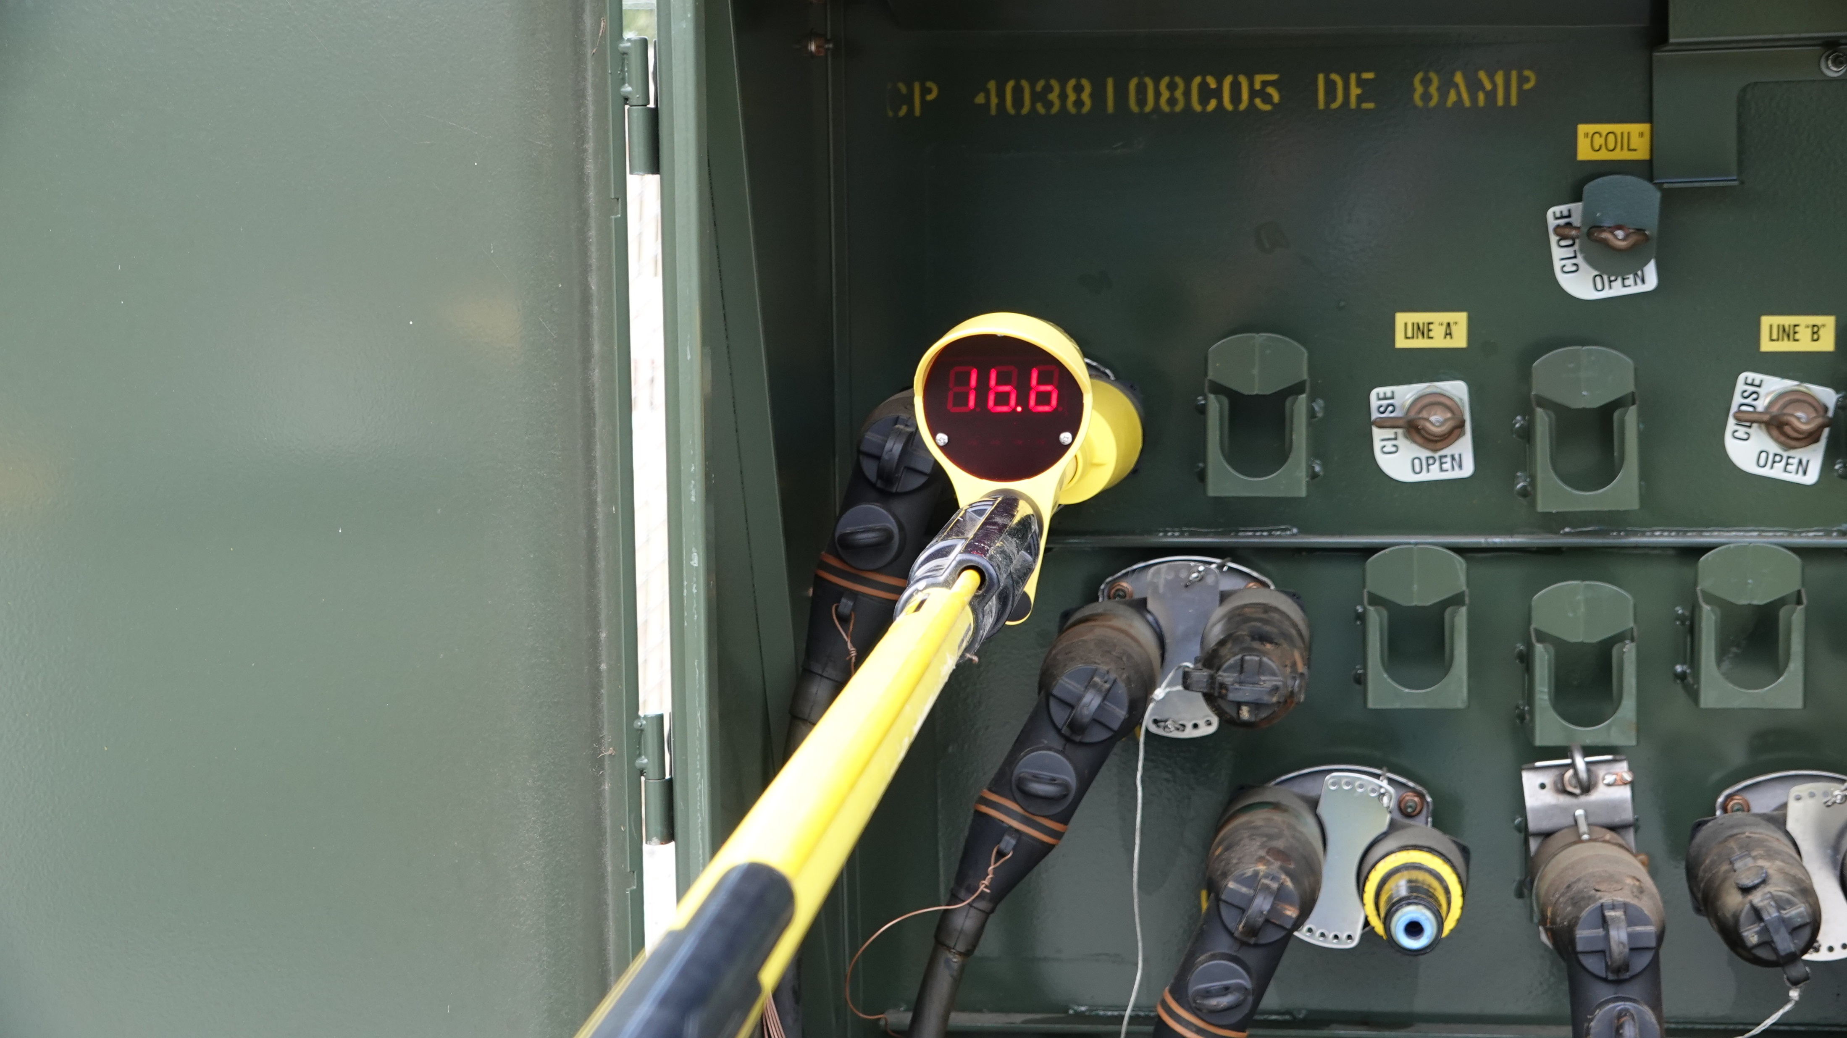
URD Switch Position
Bad Spacing
Nominal voltage reading
inside pad mount of 16.6kV
with bad perimeter spacing
causing more current to flow
through meter
*Notice*
Voltage is almost 1kV higher
than voltage with better
spacing
Good Spacing

Slide 15
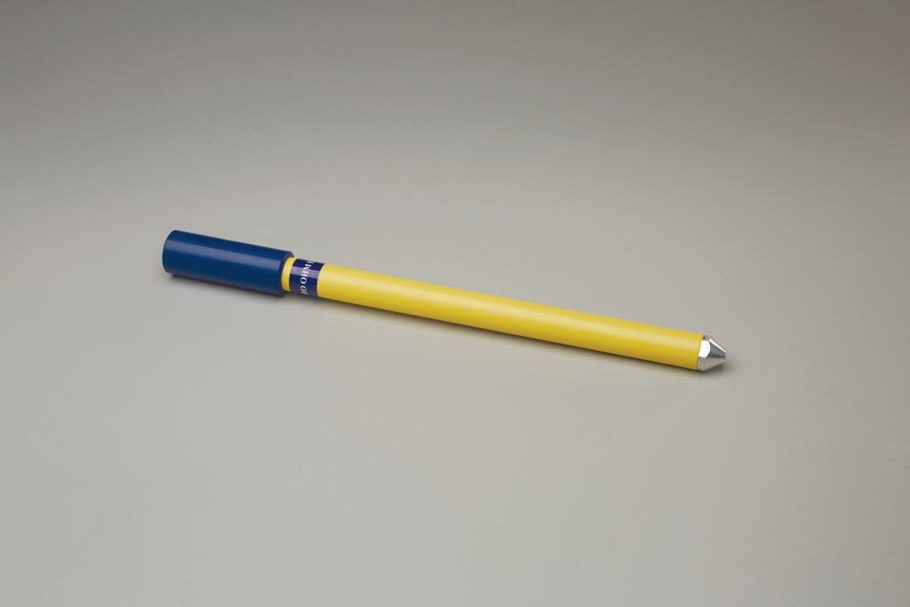
Zero Ohm Extension Probe
Insulated Collar threaded over
conductive meter probe tip
Conductive tip
16 inch Extension to remove the device away from
any unwanted ground or energized potentials
Multiple Extensions can be added together as
necessary to create a more safe working environment

Slide 16
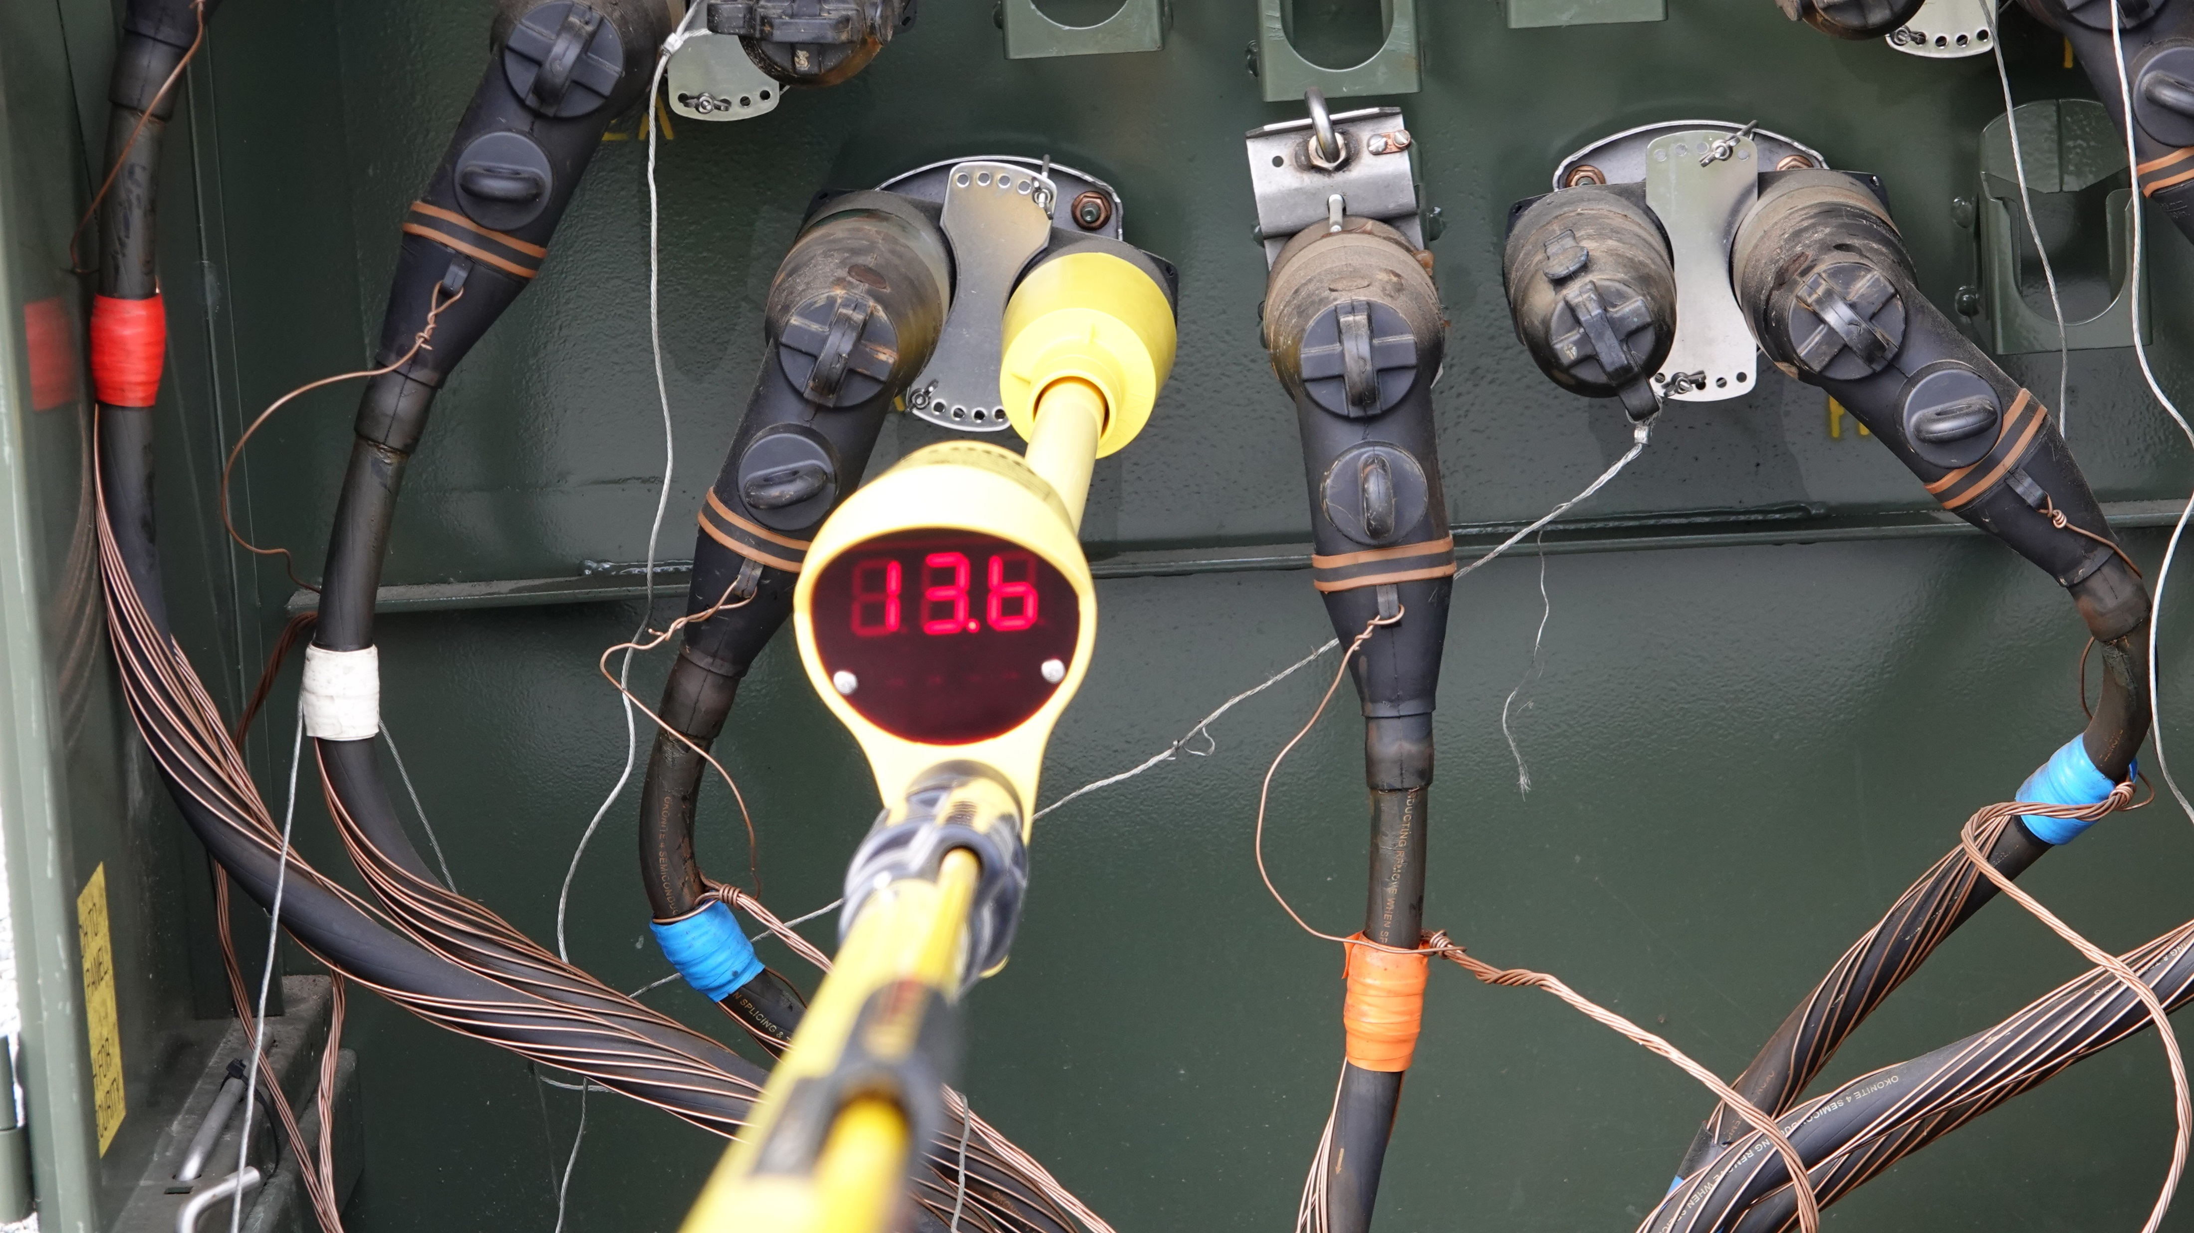
URD Switch Position
Nominal Voltage Reading
Outside padmount of 13.6kV (previously 15.9kV) with good perimeter spacing using
the Zero Ohm Extension Probe,
improved spacing behind meter.
Reading is within
1% of RMS reading

Slide 17
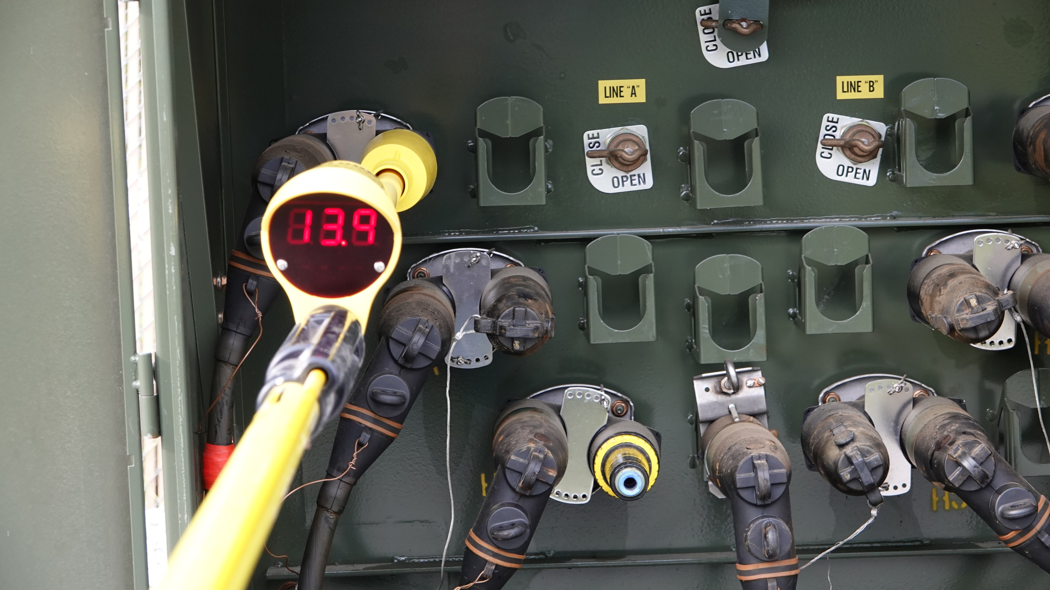
URD Switch Position
Nominal Voltage Reading
Outside pad mount of 13.9kV (previously 16.6kV)
with better perimeter spacing using
the Zero Ohm Extension Probe
*Notice*
Voltage is still within
1% in what used to be
as high as 17%

Slide 18
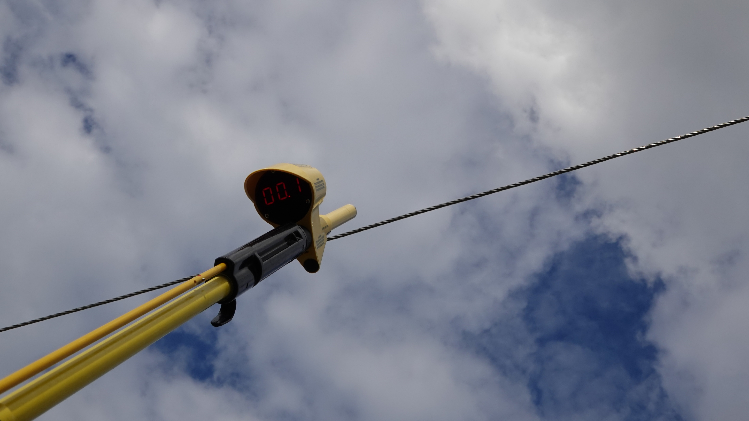
VD1000 OH Switch Position
Minimum approach, approximately 2ft away,
meter can already begin to sense a long source
Potential
Notice:
No hook probe

Slide 19
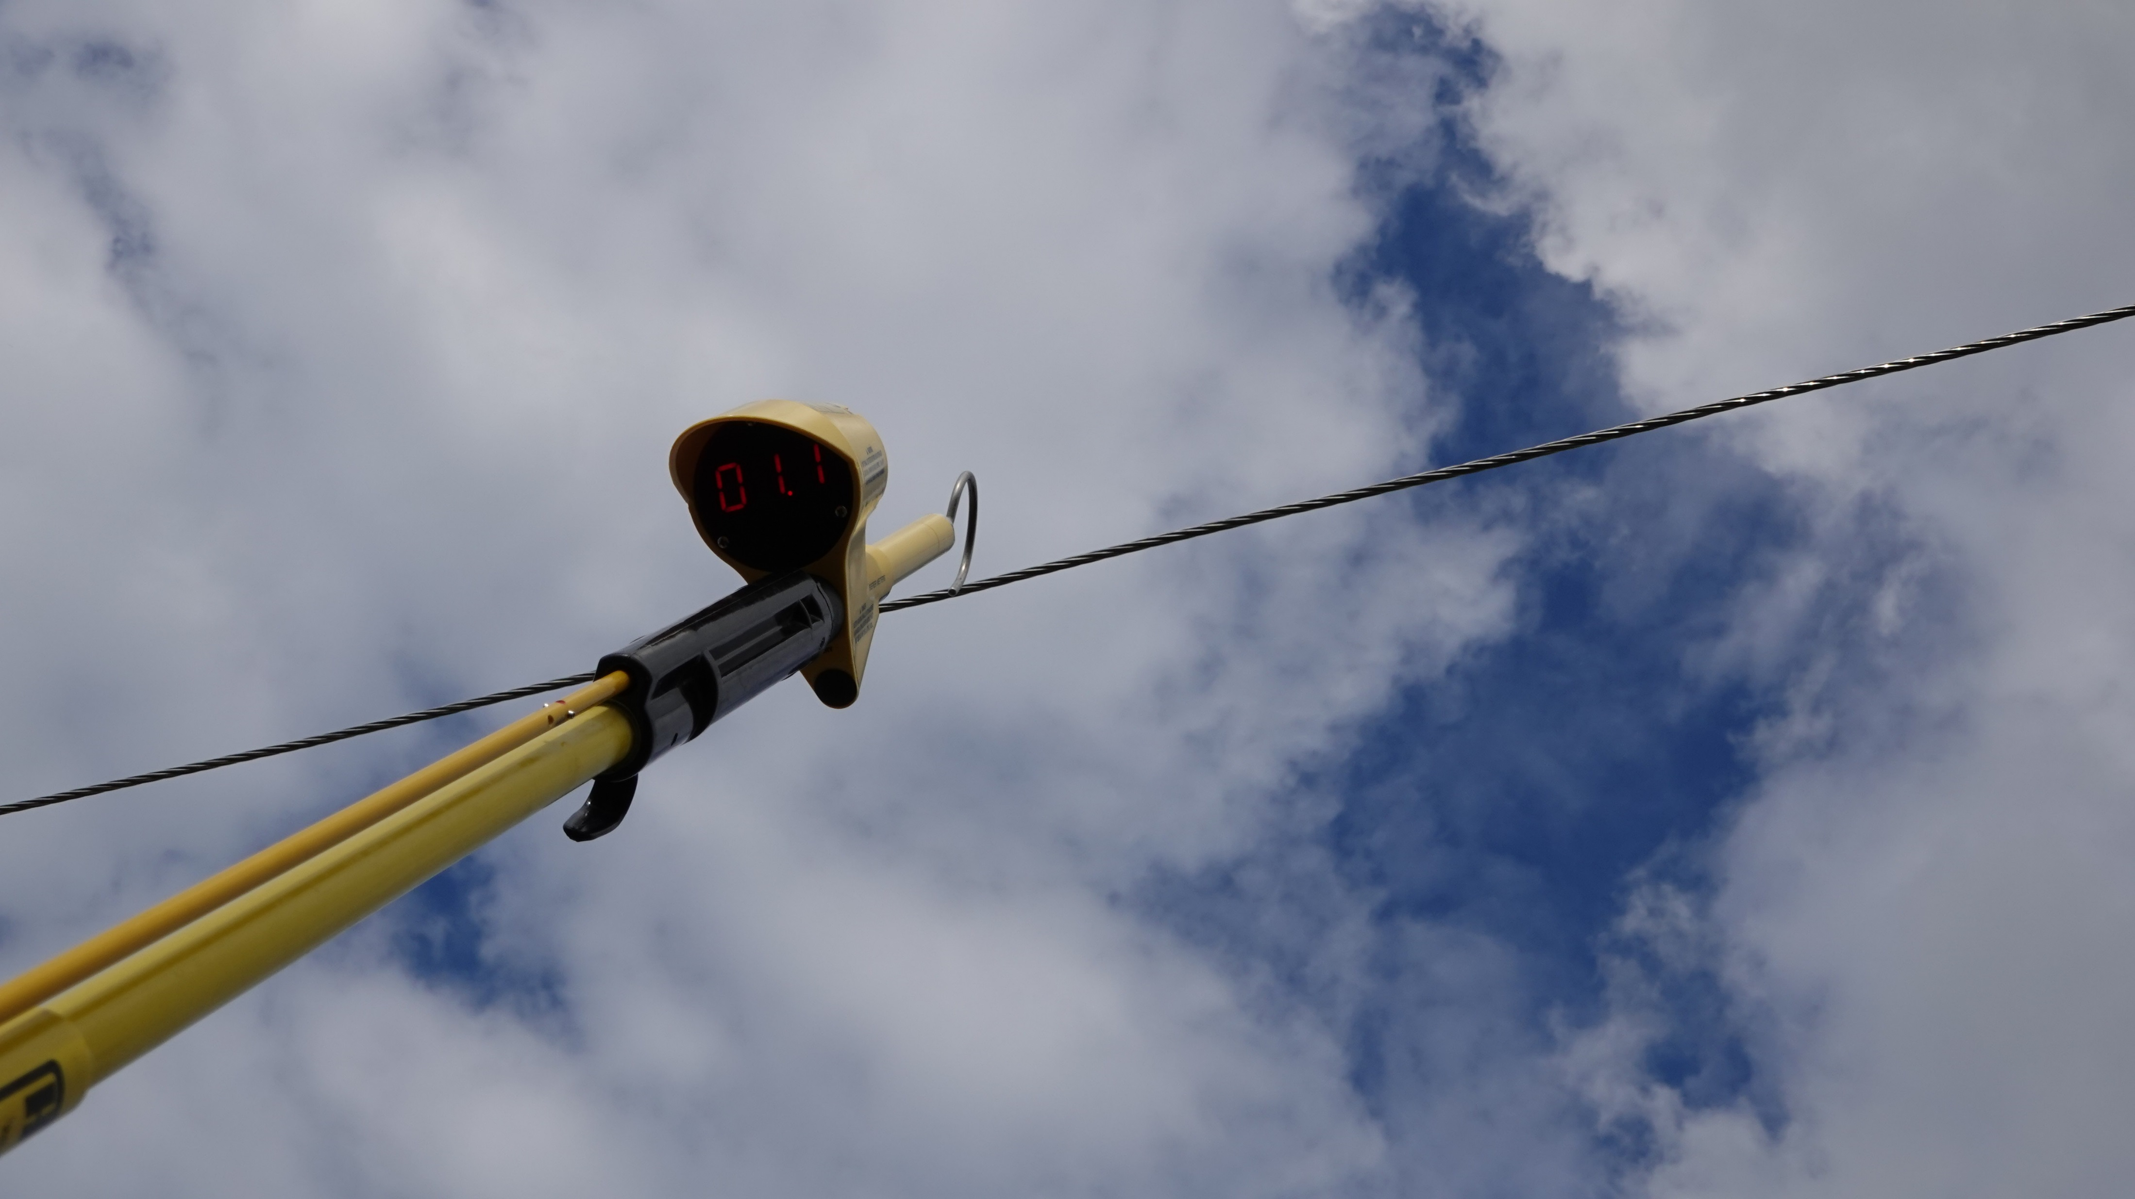
VD1000 OH Switch Position
Minimum approach, approximately 2ft away,
meter can sense a long source Potential much
better with a hook probe because it has added
surface area (more mass) to the meter probe
conductive tip, therefore causing more current
to flow through the meter

Slide 20
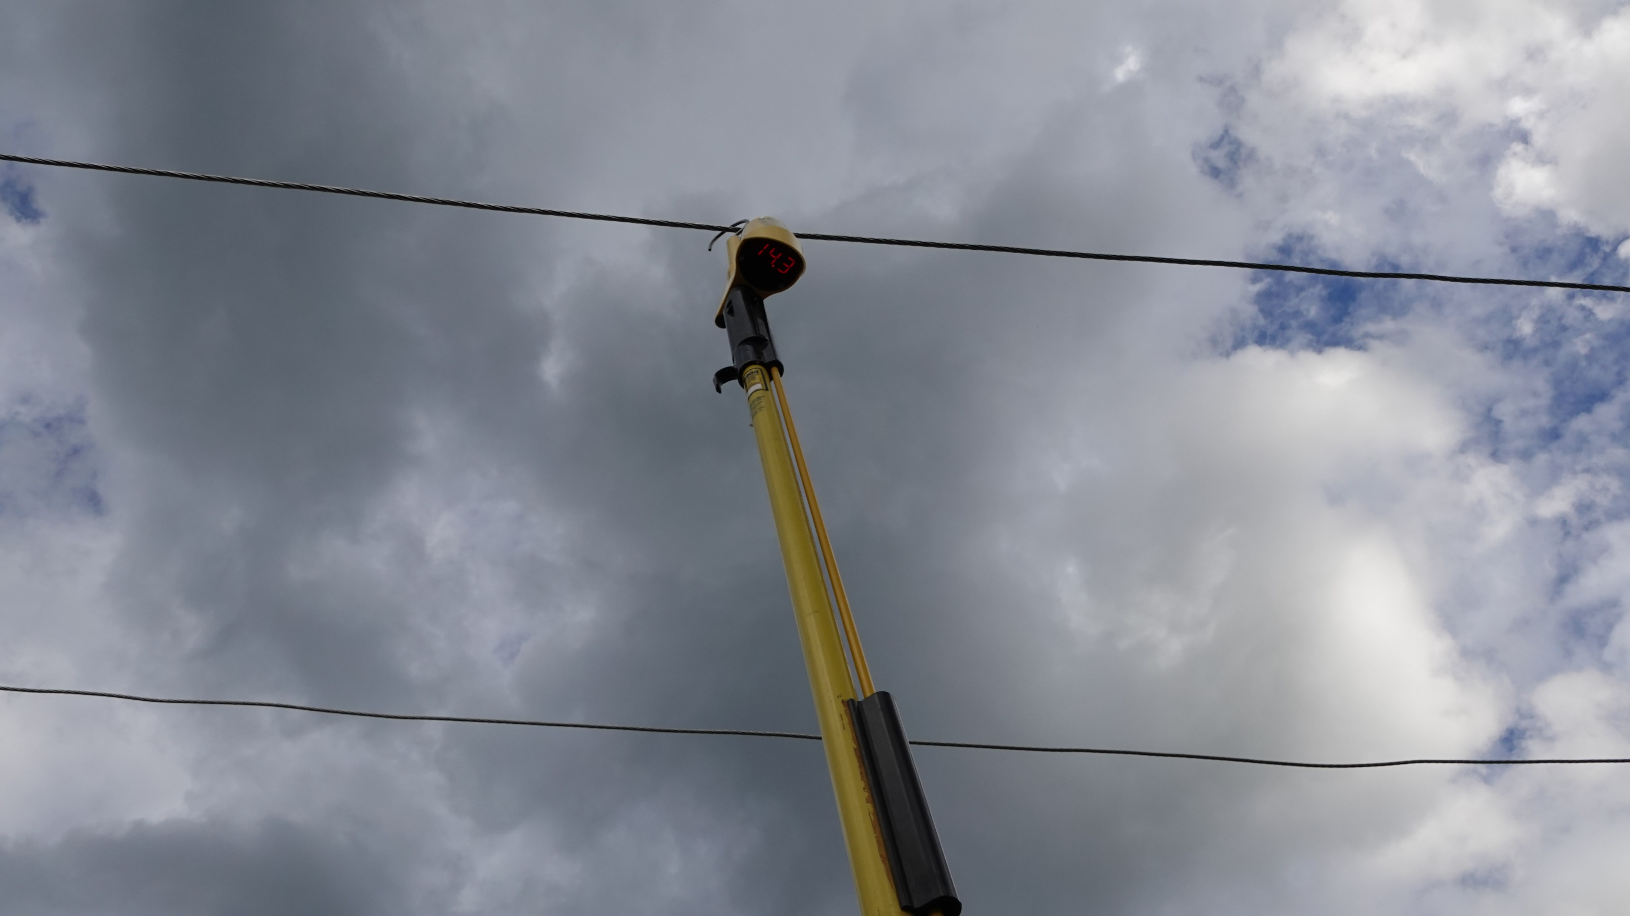
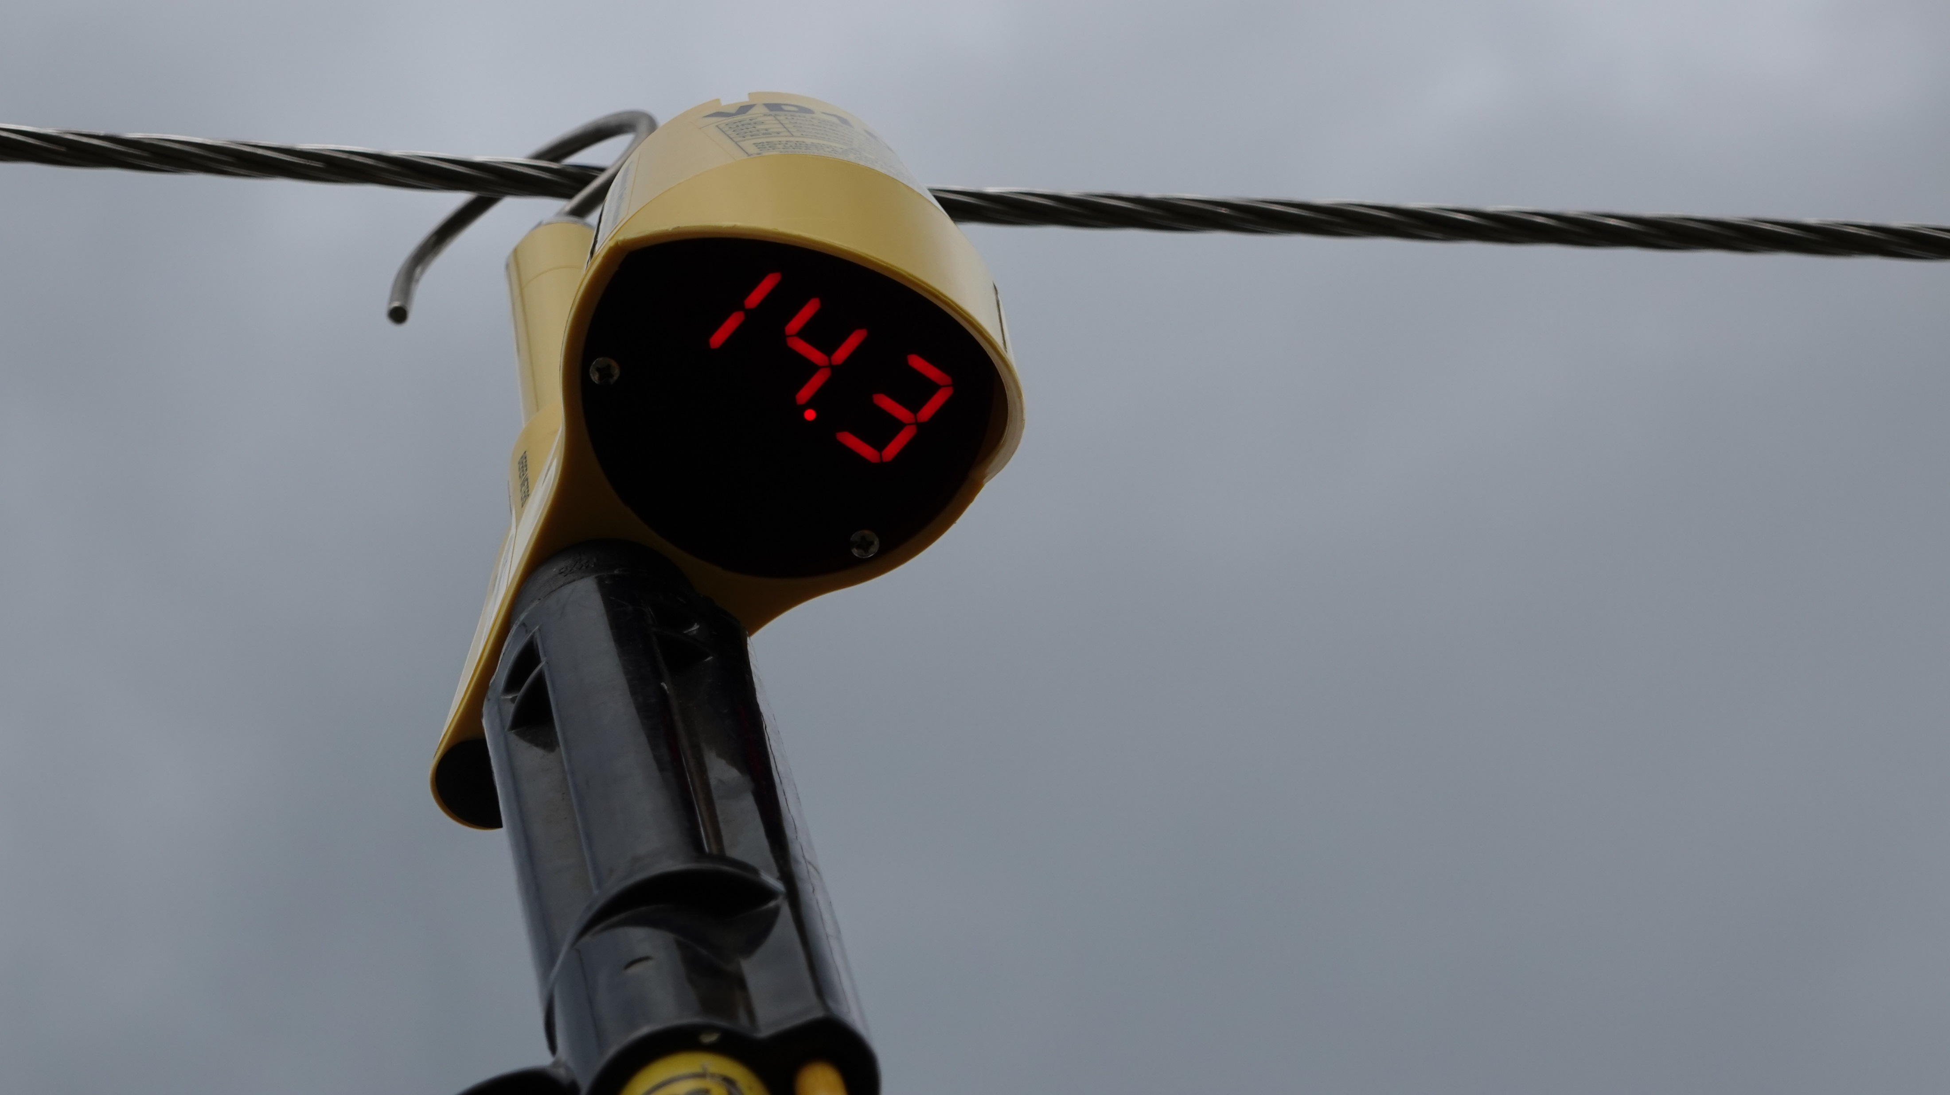
VD1000 OH Switch Position
Roadside phase
Approach is Perpendicular
Good Nominal Voltage reading
Note: Training facility overhead area
Is NOT correct height (15ft or less) so
readings should be slightly high

Slide 21
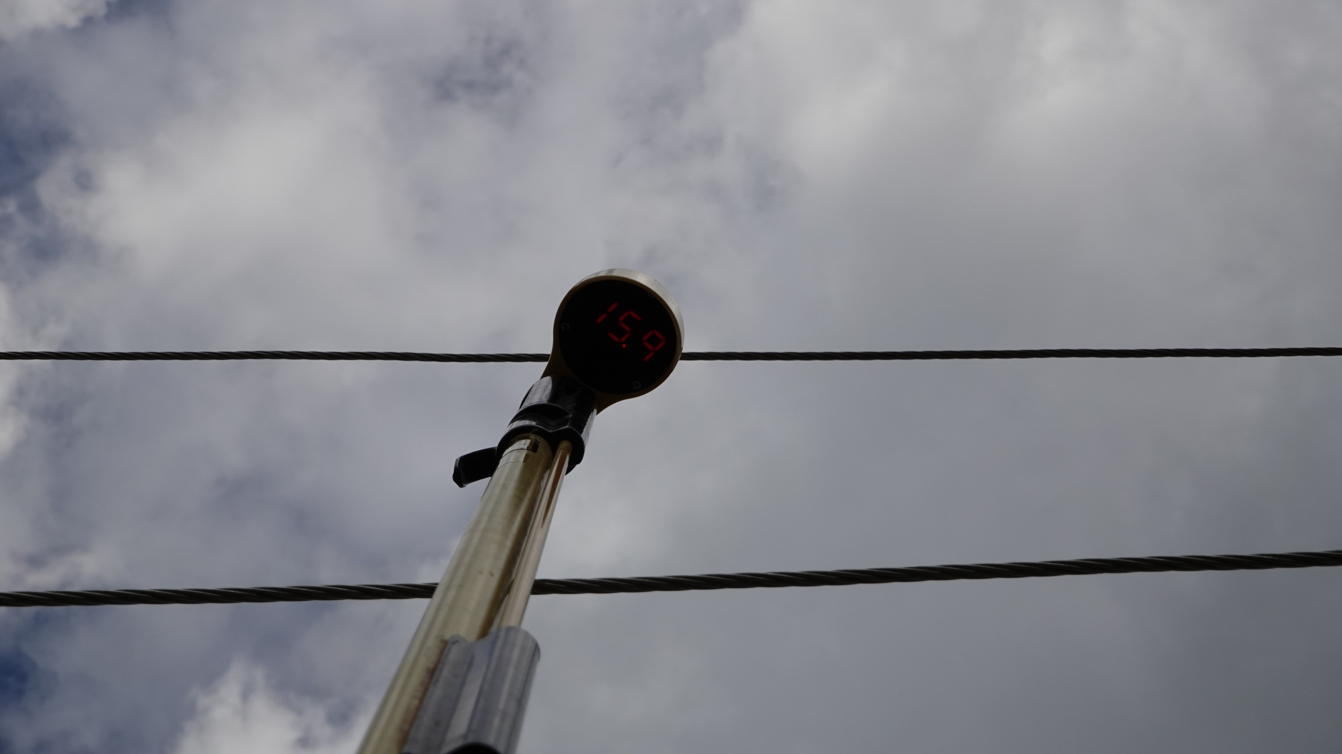
VD1000 OH Switch Position
Close proximity to Neutral (Ground) = Higher
(over 1kV) reading than Roadside Phase Conductor.
If possible, rotate away from neutral to obtain
a more accurate Nominal Voltage reading
Middle Phase Conductor
Neutral Conductor

Slide 22
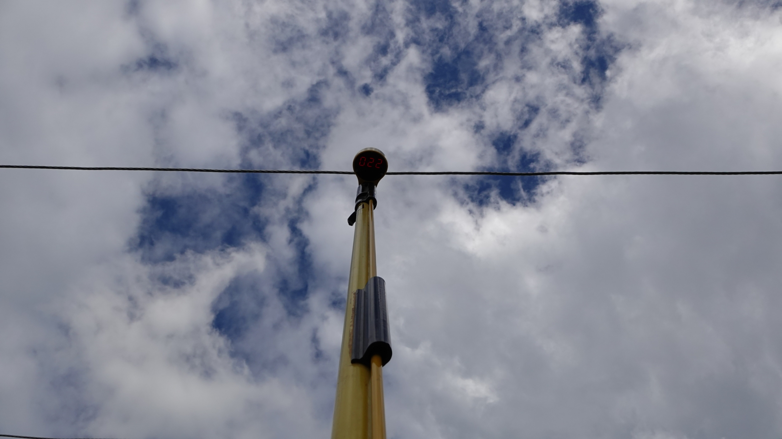
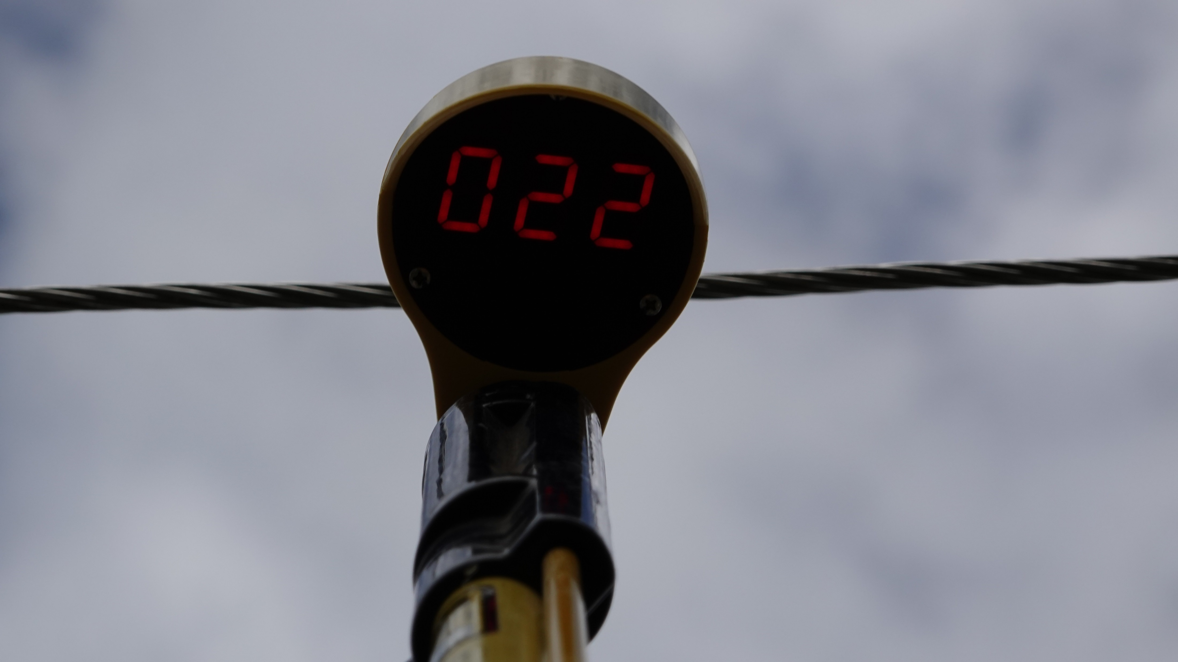
VD1000 OHT Switch Position
Roadside Phase
Approach is Perpendicular
Only approximately 15ft above ground potential,
much less than the 40ft or greater necessary, so
meter has more current = higher reading
Just as in the URD demonstrations, if the wrong switch position is used the reading will respond, high or lower vs. the height above/around ground potential

Slide 23
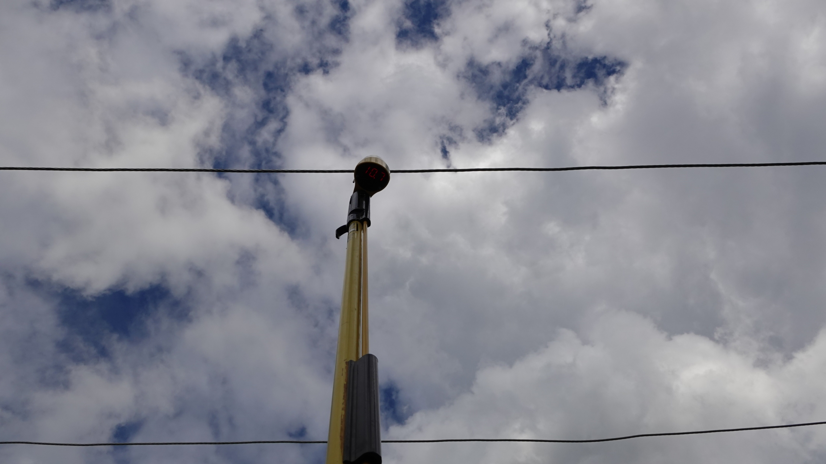
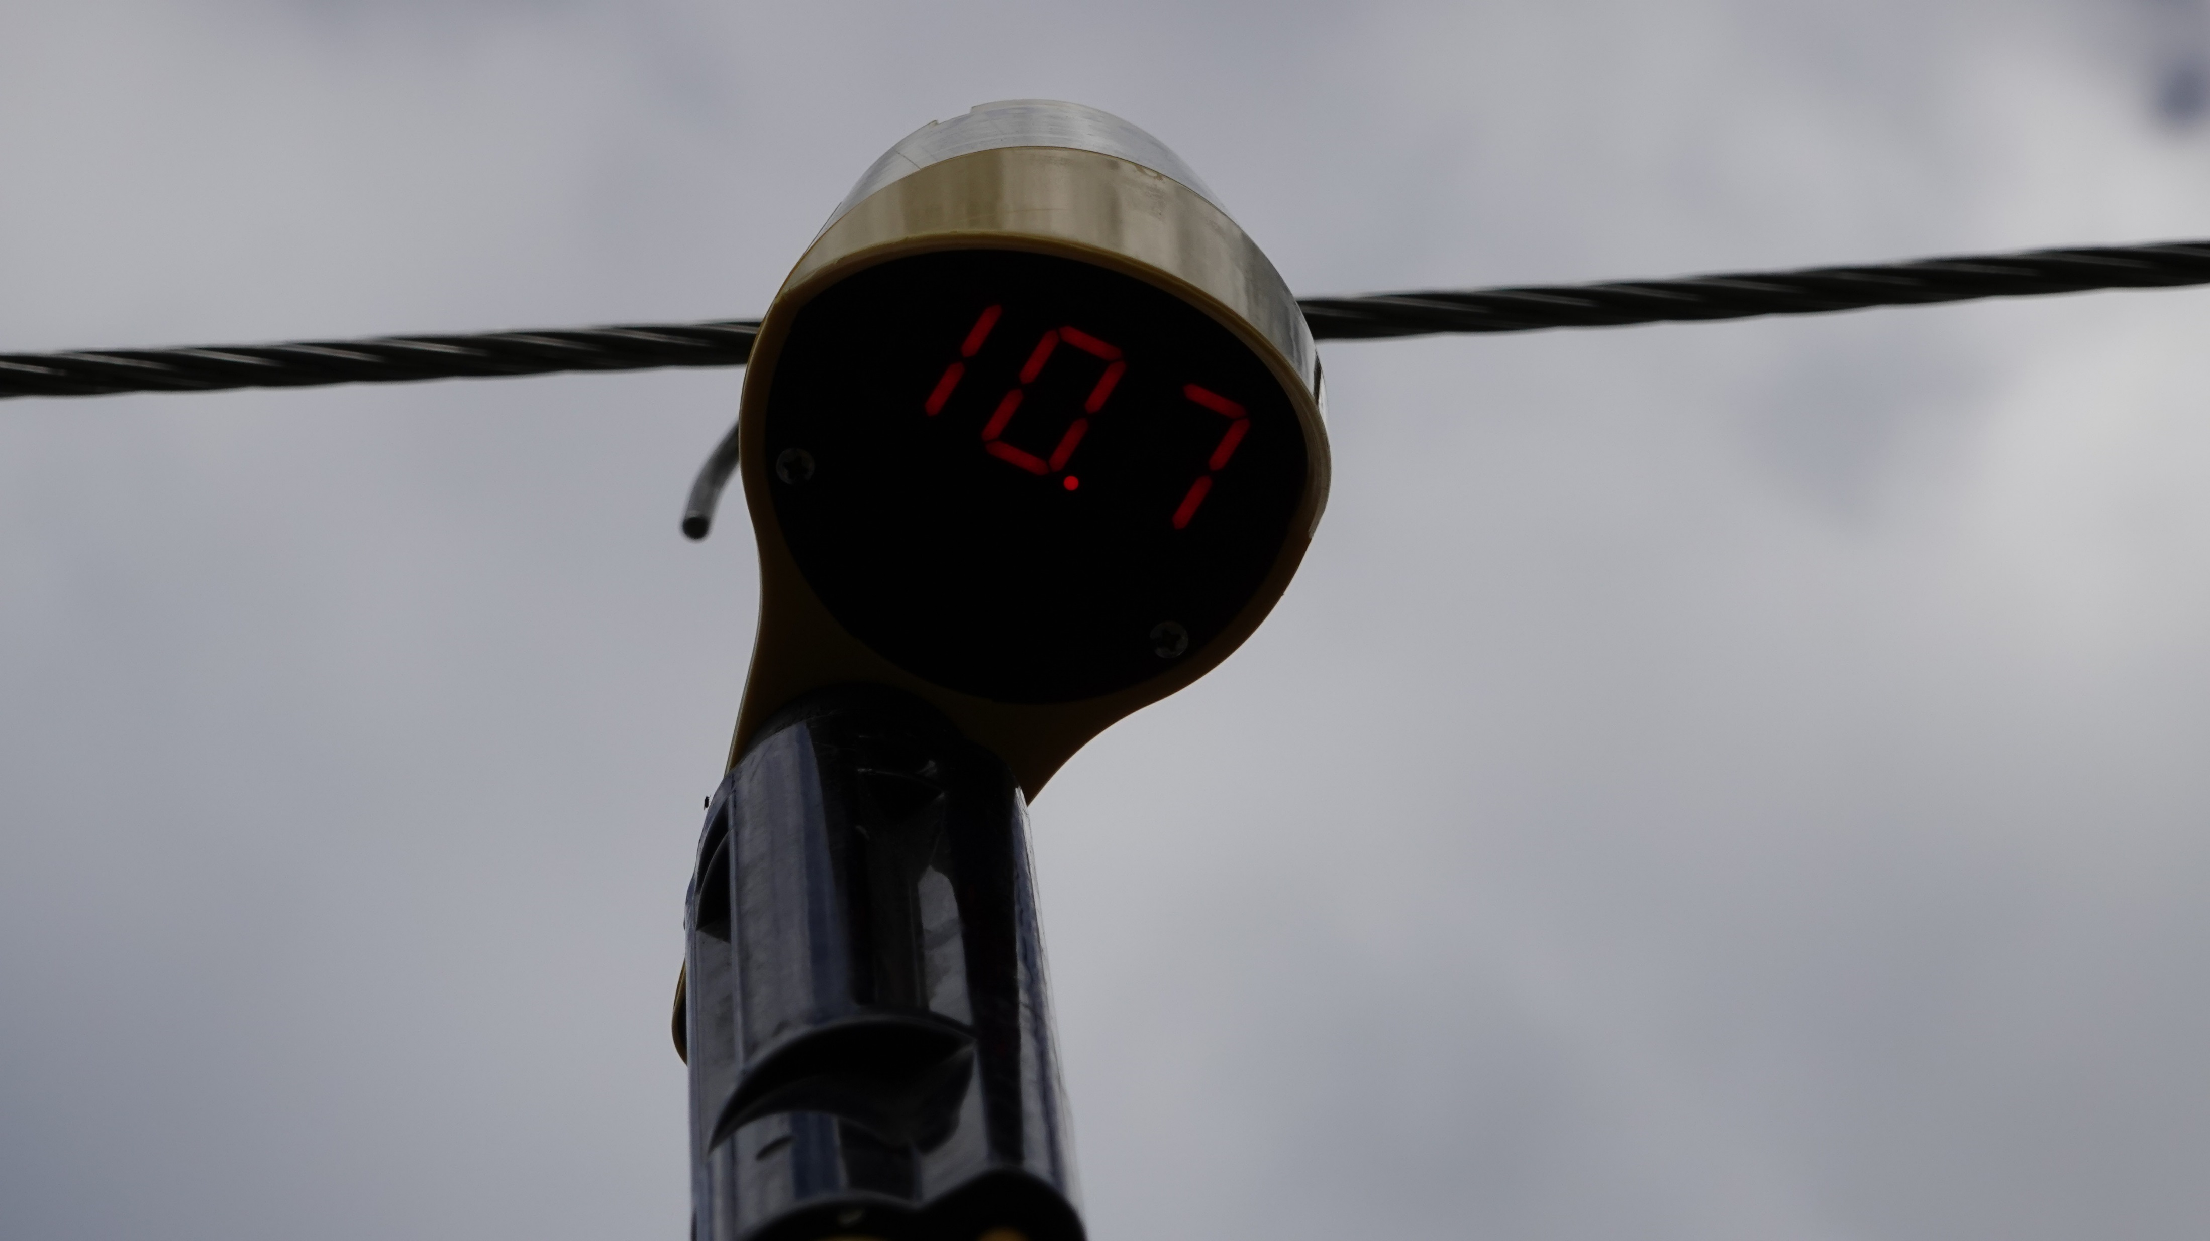
VD1000 URD Switch Position
Roadside Phase
Approach is Perpendicular
15ft above ground potential, much greater
than 6ft or less, so meter has less current =
lower reading
Just as in the URD demonstrations, if the
wrong switch position is used the reading
will respond, high or lower vs. the height
above/around ground potential

Slide 24
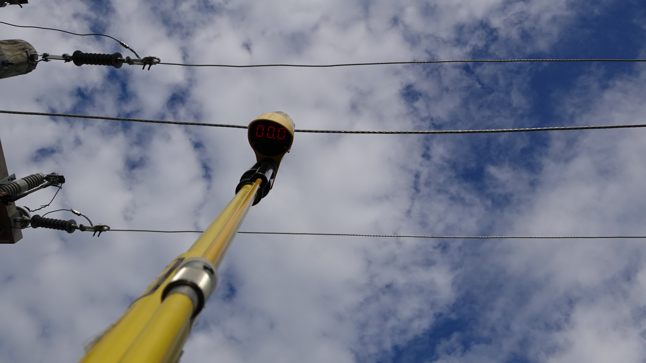
VD1000 OH Switch Position
Neutral Conductor
Approach is Perpendicular
Reading is correct
In this position, the VD1000 is not able to capacitively
couple with energized conductors above it

